Slide 1
Using Defect Creation for Directional Sensitivity and Dark Matter Signal Discrimination in Phonon-Mediated Detectors
Feđa Kadribašić
Abstracts O-35, PE-16
Mirabolfathi Group
Texas A&M University
July 18, 2017

Slide 2
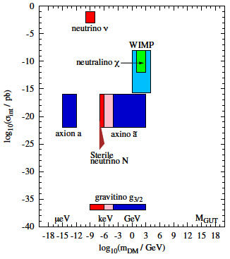
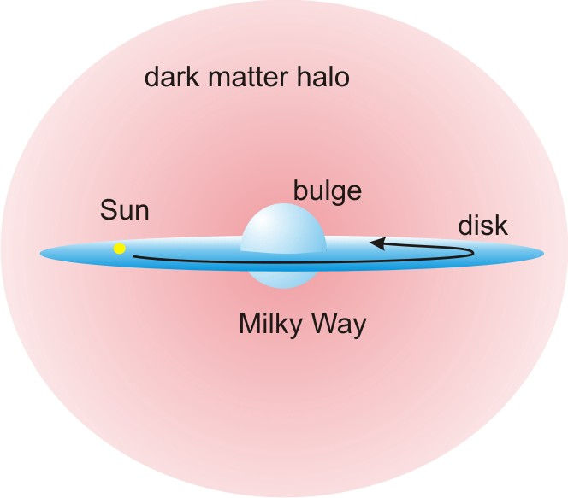
Perspective
Dark matter
~85% of mass content of the Universe
Many particle candidates covering large range of masses
DM halo implies isothermal Maxwell-Boltzmann distribution
Expected challenges: low energy deposition, low signal rate ~0.3 event/kg/yr
https://cdn-images-1.medium.com/max/1600/1*ZI42DqEBKiV7WhClVBz6cw.jpeg

Slide 3
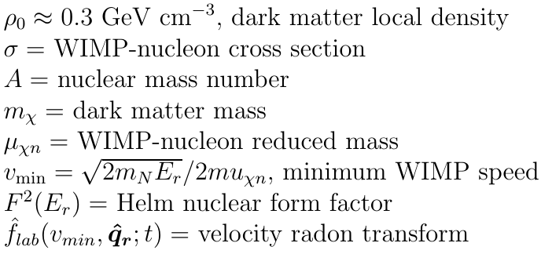
Dark Matter Expected Rate
Ciaran A. J. O’Hare et al, Phys. Rev. D 92, 063518

Slide 4
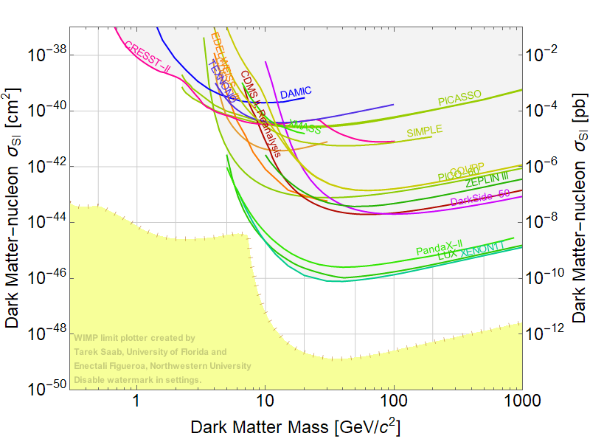
Dark Matter Direct Detection Limits
SuperCDMS
LZ

Slide 5
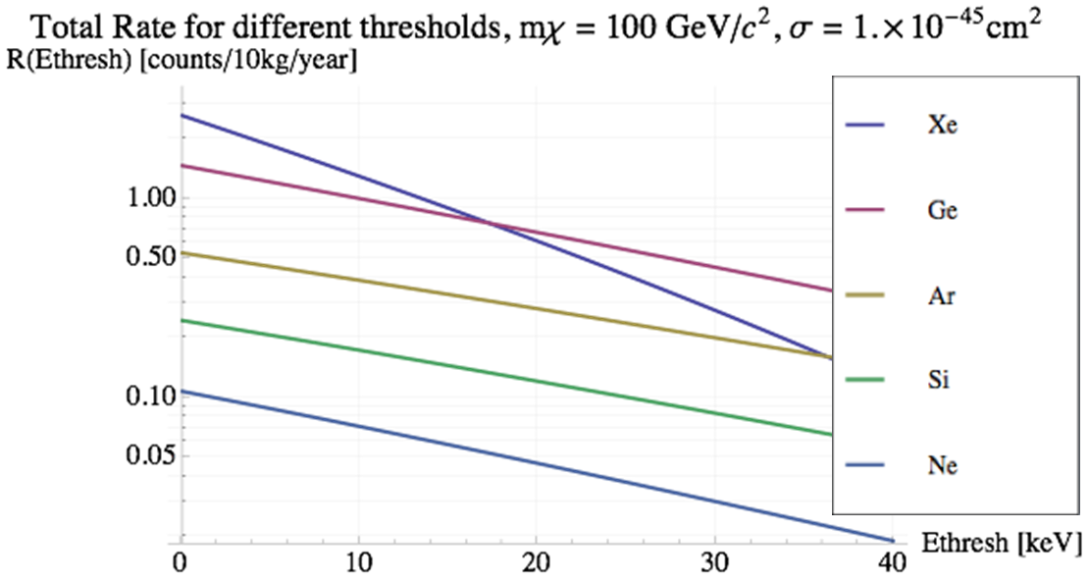
Signal from a 100 GeV WIMP

Slide 6
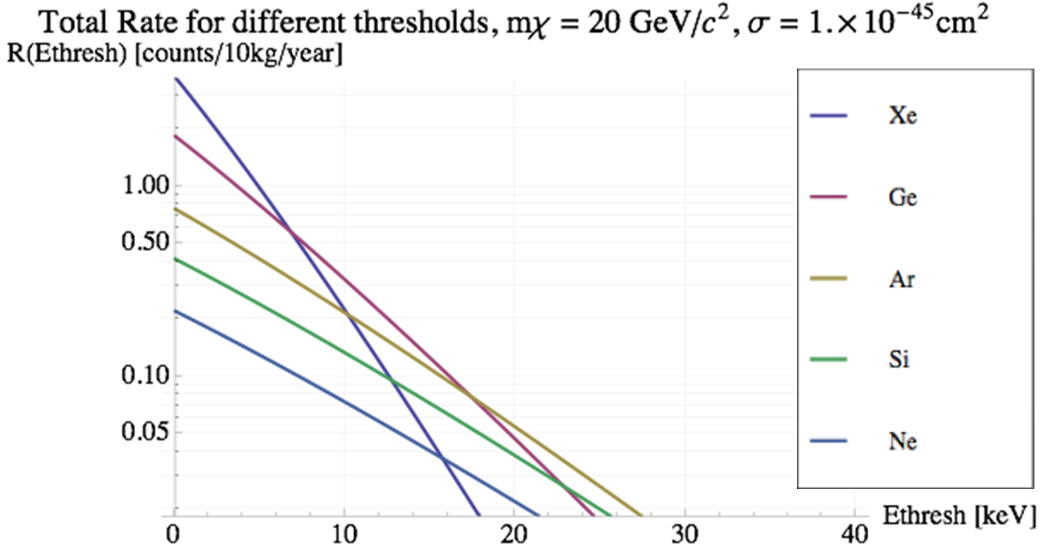
Signal from a 20 GeV WIMP

Slide 7
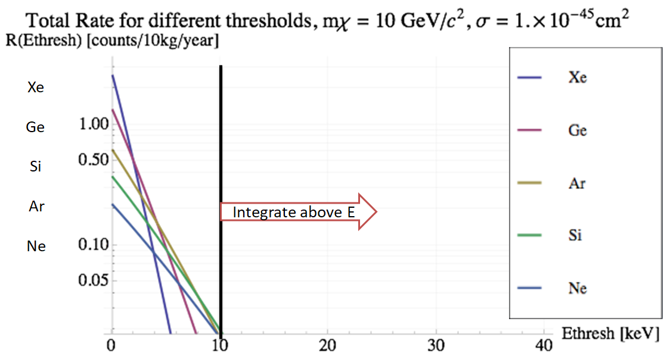
Signal from a 10 GeV WIMP
Need < 100 eV_{ne}

Slide 8
Dark Matter Direct Detection Status
SuperCDMS
LZ

Slide 9
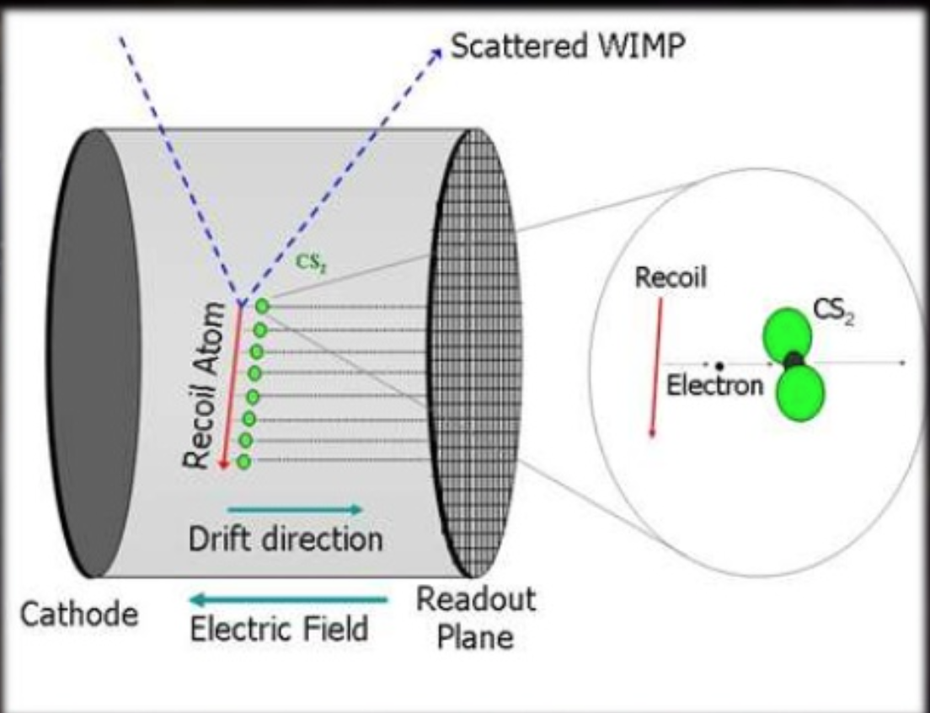
Directional Dark Matter Searches
DRIFT experiment
Time projection chamber (TPC) with low-pressure gas
Advantage – strong directional effect
Disadvantage –low exposure due to mass, high energy threshold

Slide 10
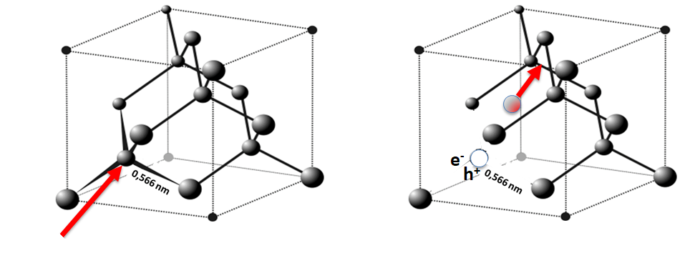
Possible Charge Creation Mechanism
WIMP or ν

Slide 11
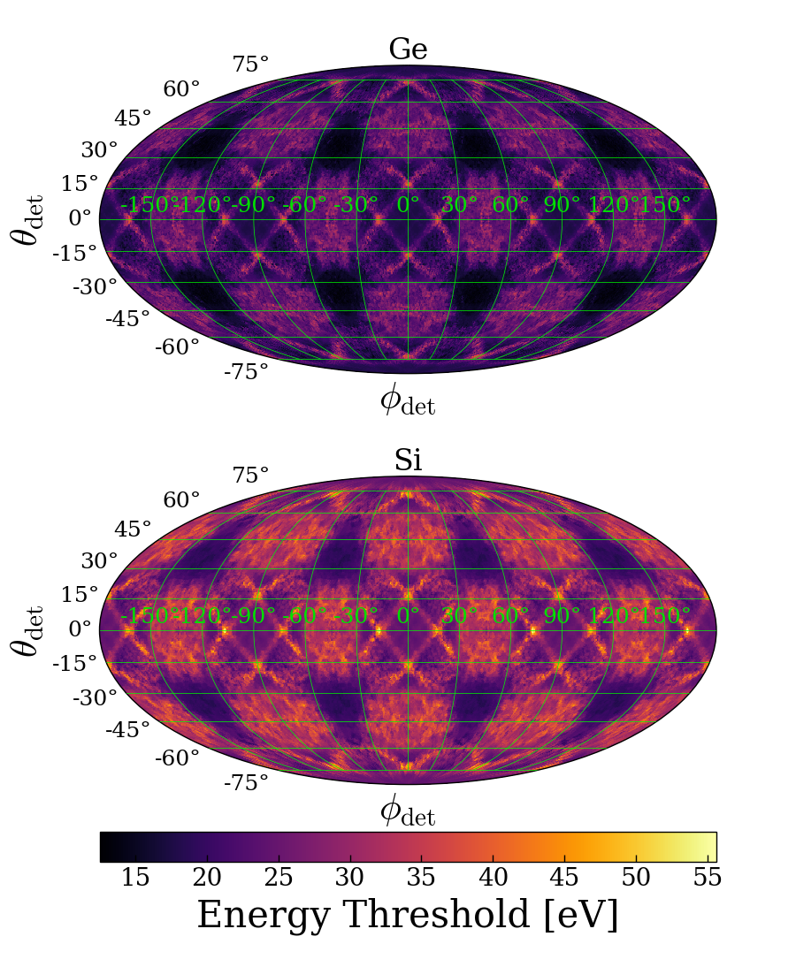
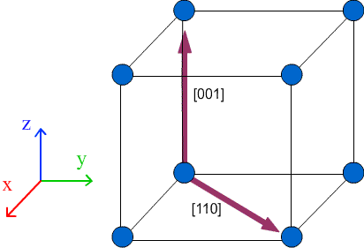
Angle Dependent Energy Thresholds
Collaboration with K. Nordlund et al, U. of Helsinki
Molecular dynamics based on density functional theory (DFT)
Ge: 12 eV to 35 eV
F. Kadribasic et al. arXiv:1703.05371, https://www.doitpoms.ac.uk/tlplib/crystallography3/images/directions.gif

Slide 12
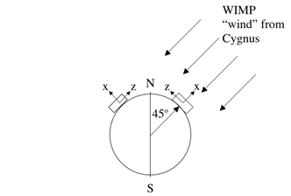
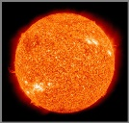
Solar ν
Solar ν
No Angular Threshold
Angular Threshold
Integrated Rate
http://slideplayer.com/slide/5208971/16/images/8/WIMP+signatures+Diurnal+modulation:+vo+a+v0:+solar+motion.jpg

Slide 13
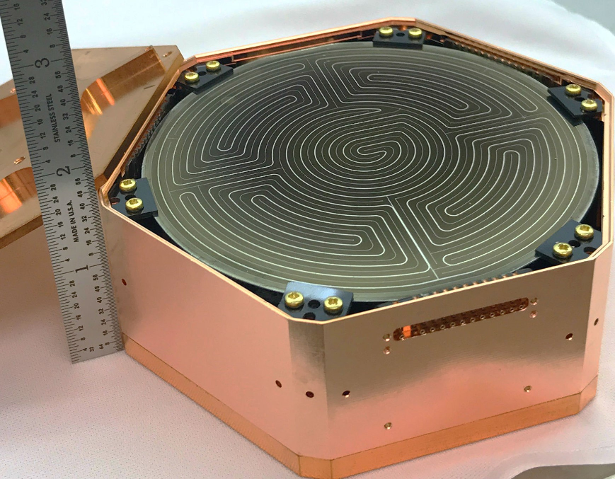
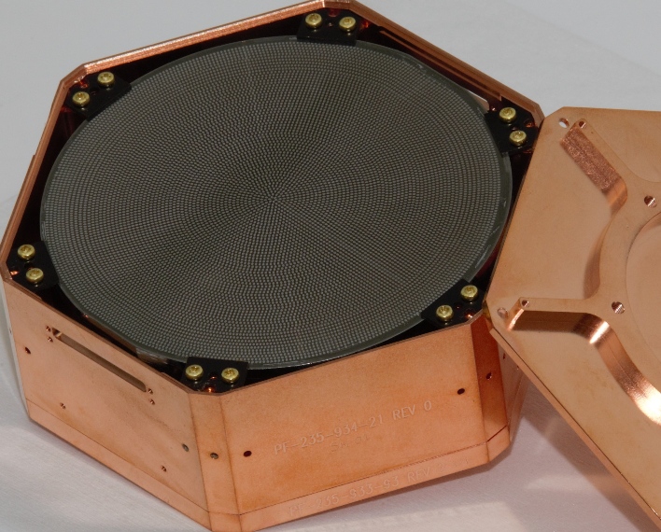
CDMS Solid State Technology
Sub 40 mK
NR vs ER discrimination
Recoil energy via phonons
Charges via ~3 V/cm E-field
Good to ~1 keV threshold
https://www.slac.stanford.edu/exp/cdms/default_files/image004.png

Slide 14
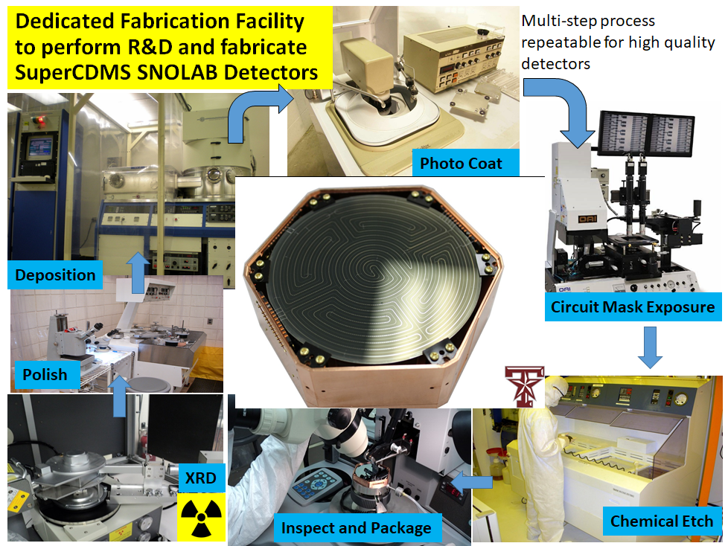

Slide 15
Luke-Neganov Gain, Ideal Detector

Slide 16
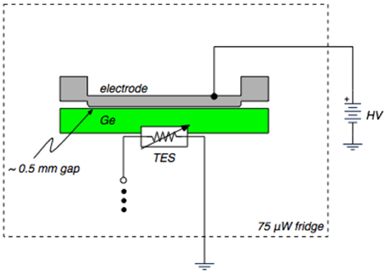
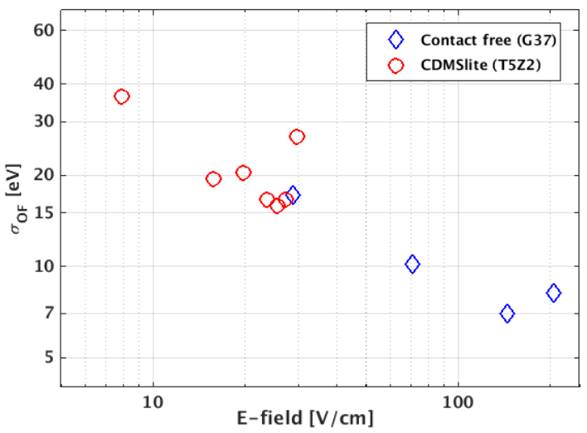
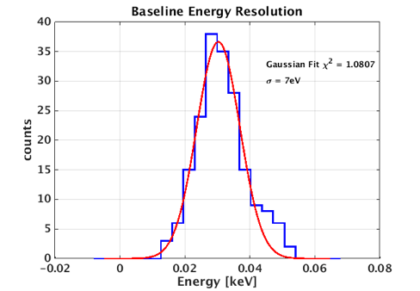
Contact-Free High Voltage Detector
N. Mirabolfathi et al, Nucl. Instrum. Meth. A855, 88 (2017), arXiv:1510.00999 [physics.ins-det].

Slide 17
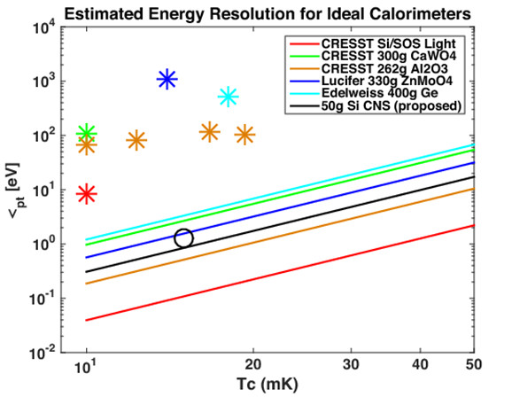
Lower Tc = Lower Threshold

Slide 18
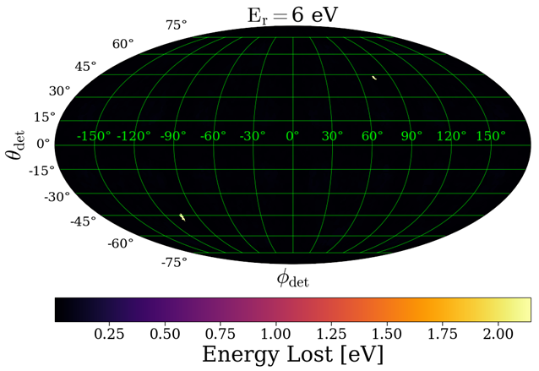
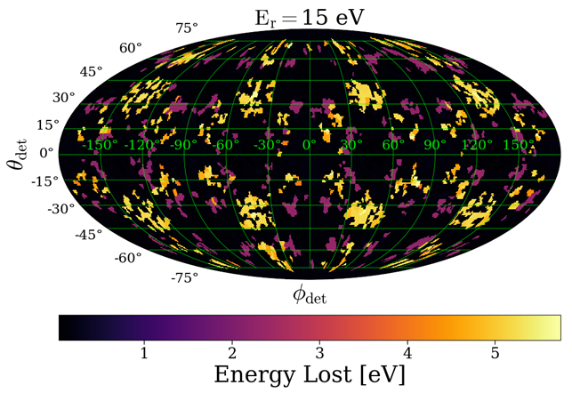
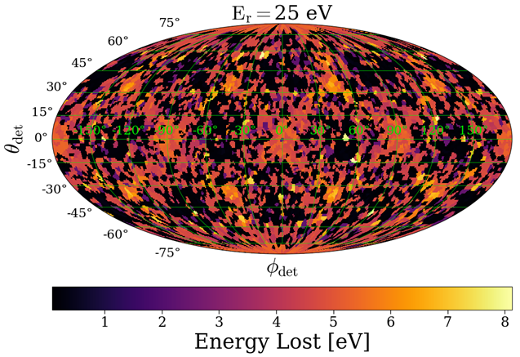
Defect Production Energy Loss
Collaboration with K. Nordlund et al, U. of Helsinki
Molecular dynamics based on DFT
Energy loss dependent on recoil energy and anisotropic

Slide 19
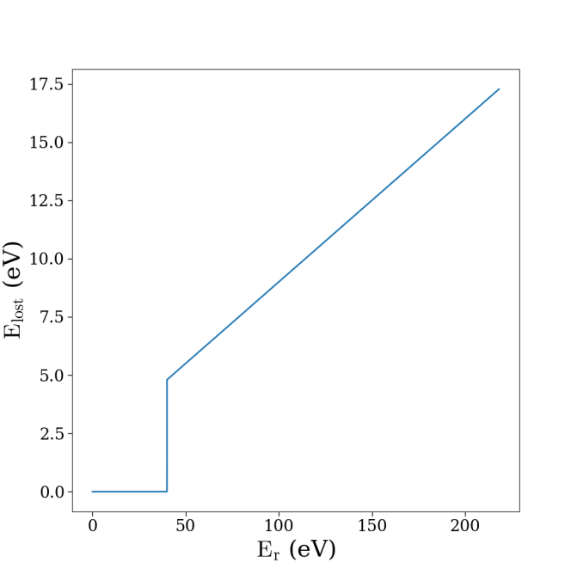
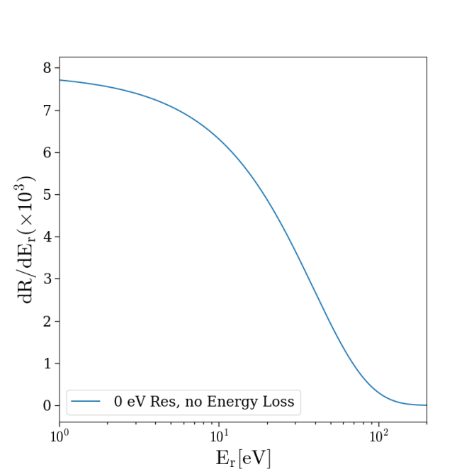
Dark Matter Modified Spectrum

Slide 20
Dark Matter Modified Spectrum

Slide 21
Dark Matter Modified Spectrum

Slide 22
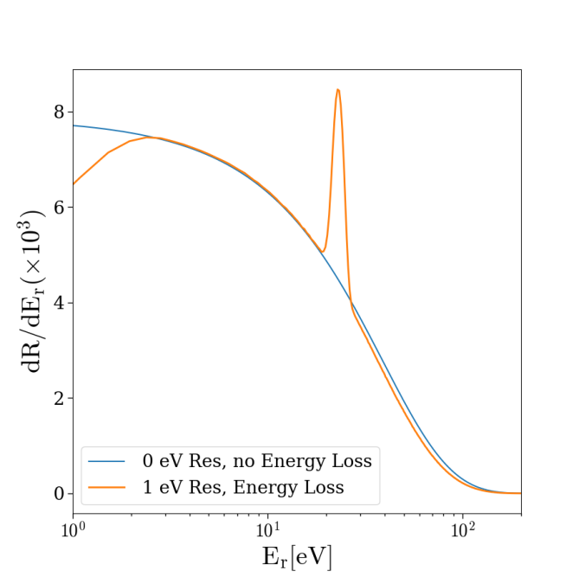
Dark Matter Modified Spectrum

Slide 23
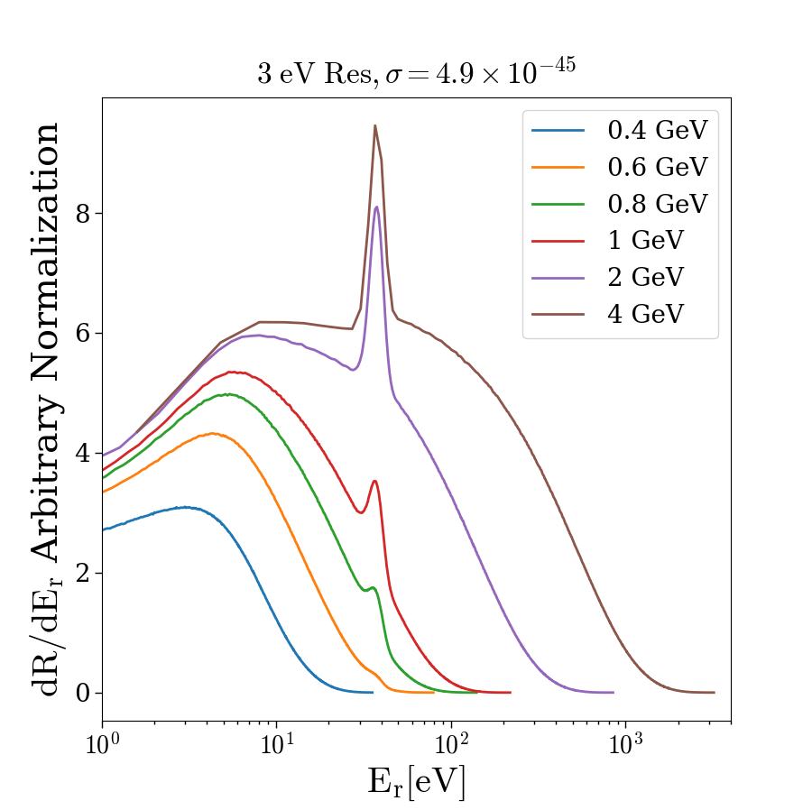
Dark Matter Modified Spectrum
Please see poster PE-16 for details

Slide 24
Summary
Directionality possible with low energy threshold solid state charge mediated phonon detectors
Luke-Neganov gain to push to ~eV energy resolution
Further discrimination power possible at single electron hole pair resolutions

Slide 25
Thank you

Slide 26
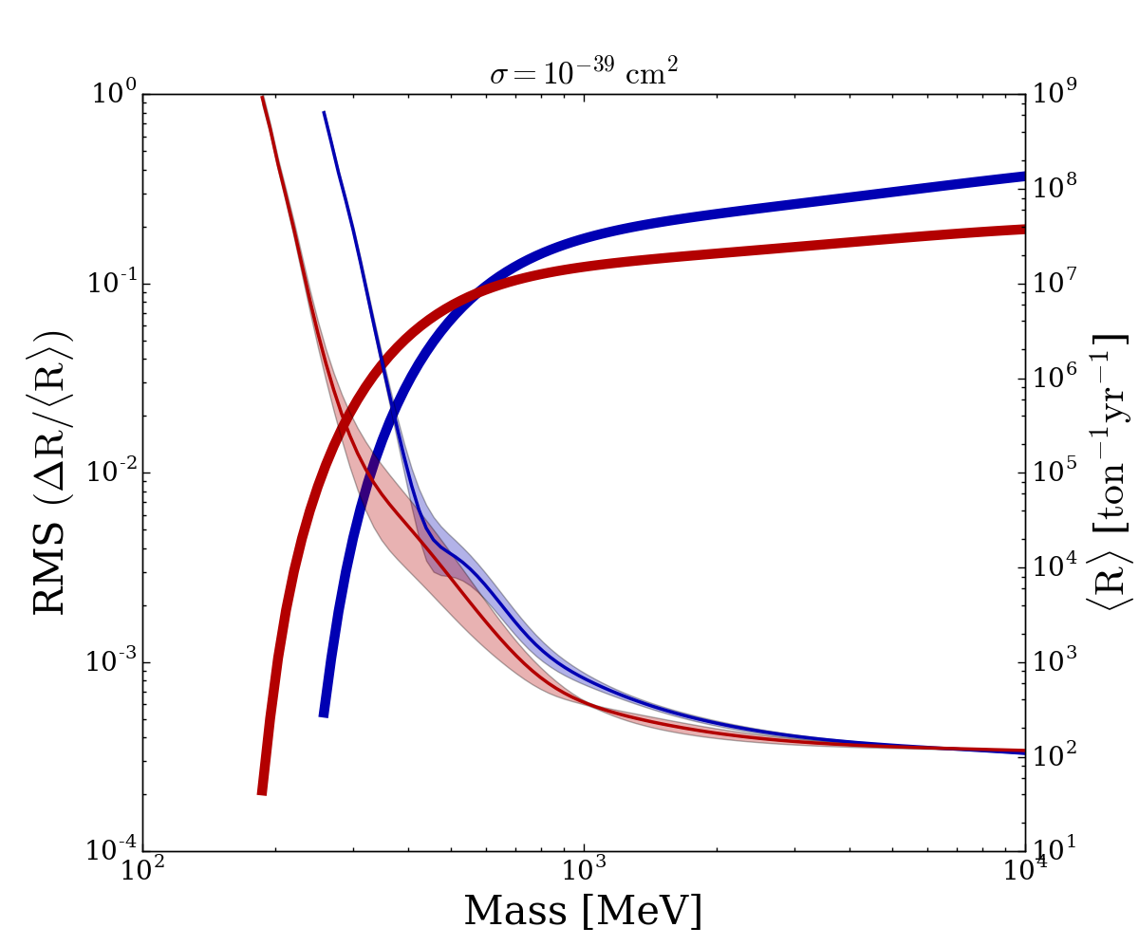

Slide 27
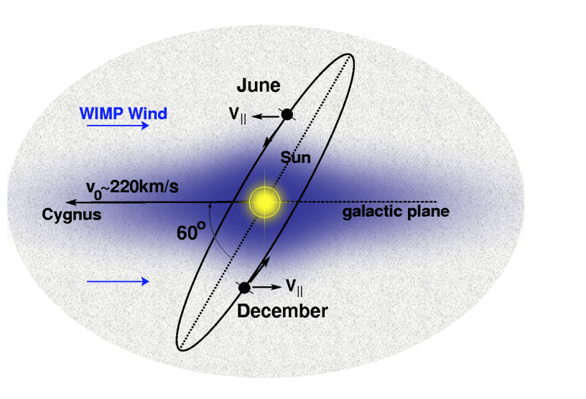
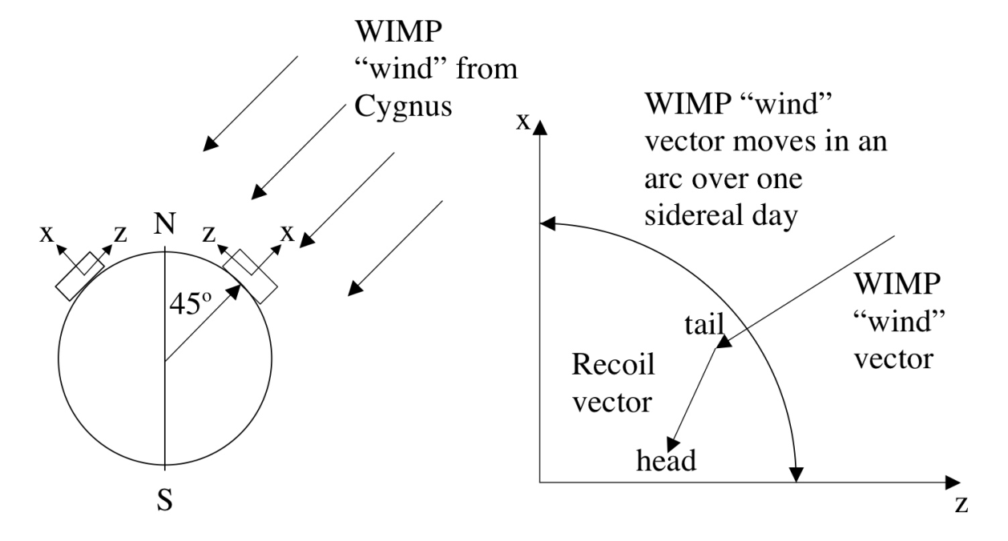
Directional Dark Matter Searches
https://www.hep.shef.ac.uk/research/dm/images/earth_in_galaxy.gif, https://inspirehep.net/record/796239/files/FIG_1_Cygnuspic.png

