Slide 1
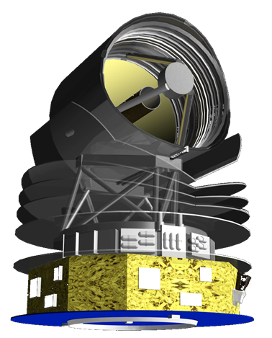
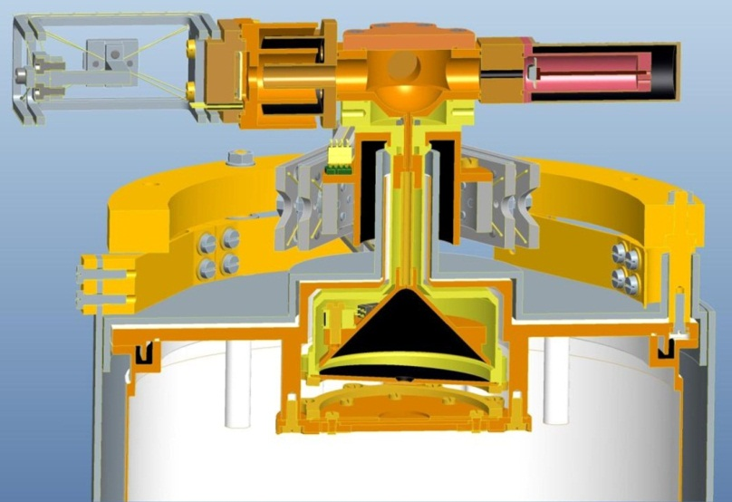
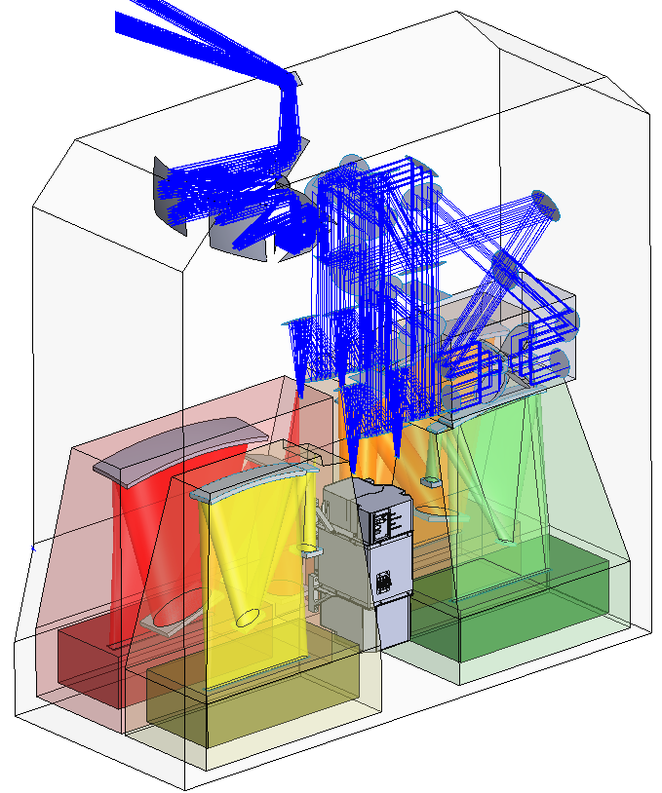
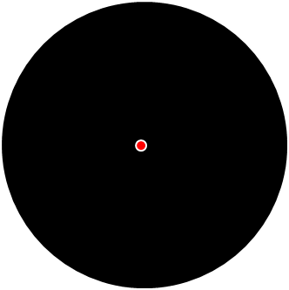
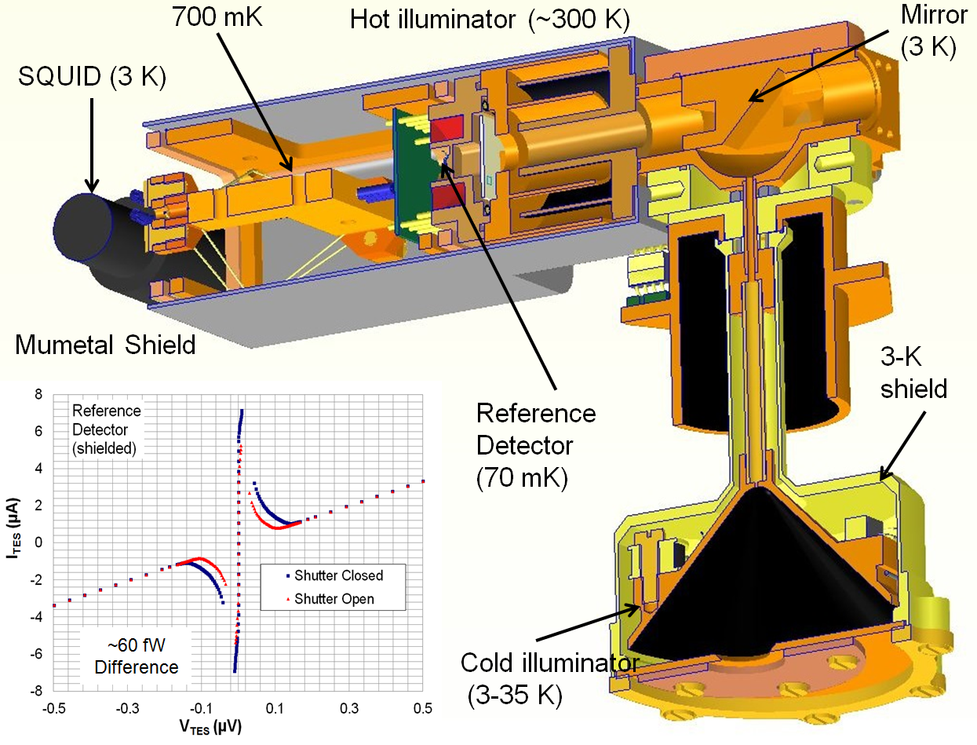
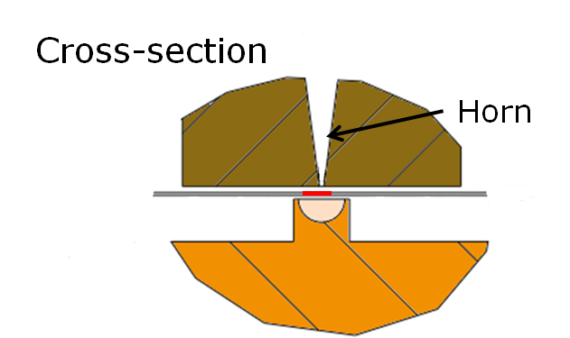
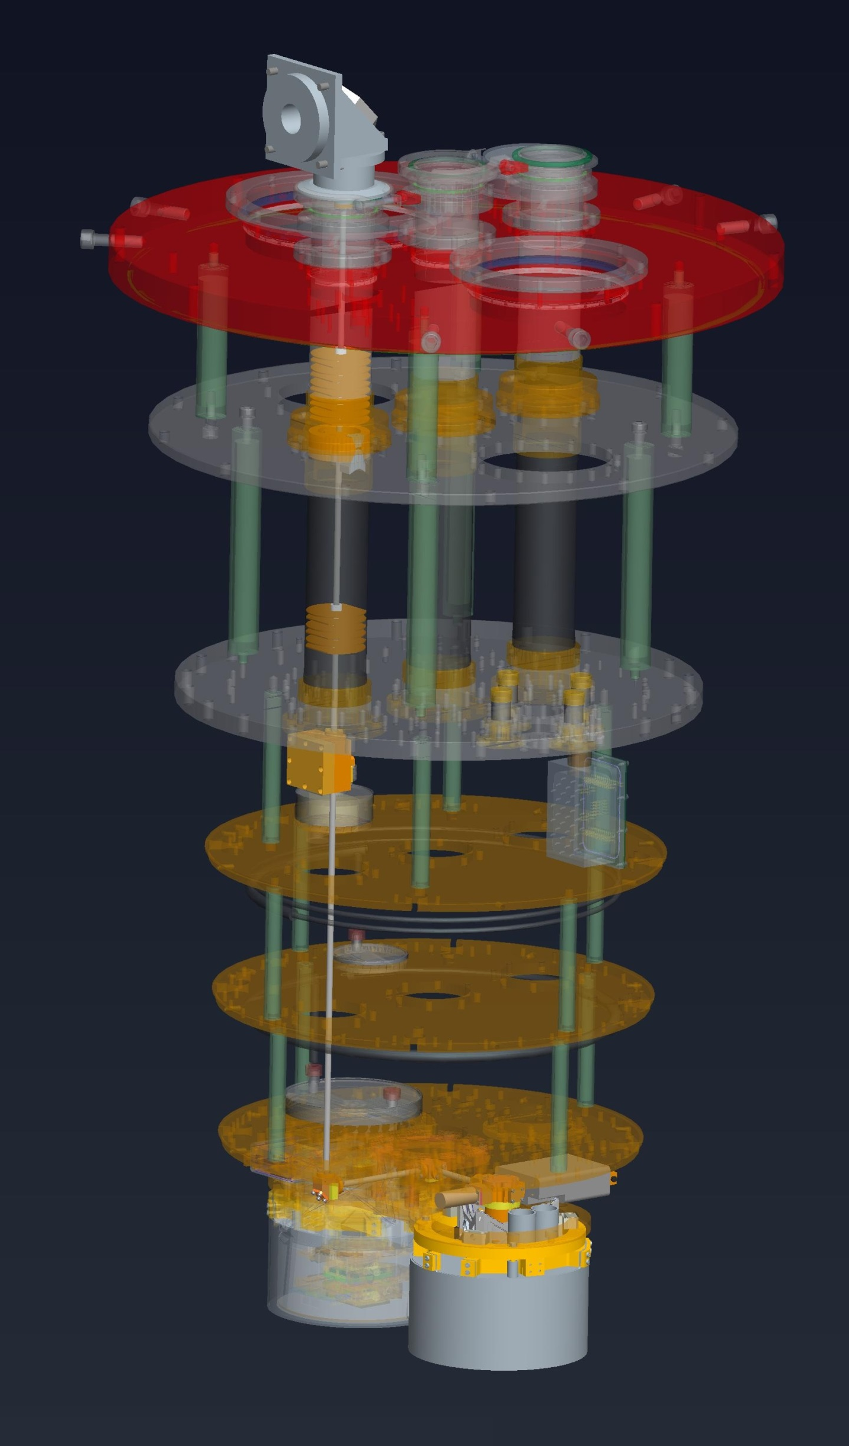
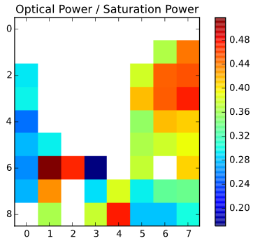
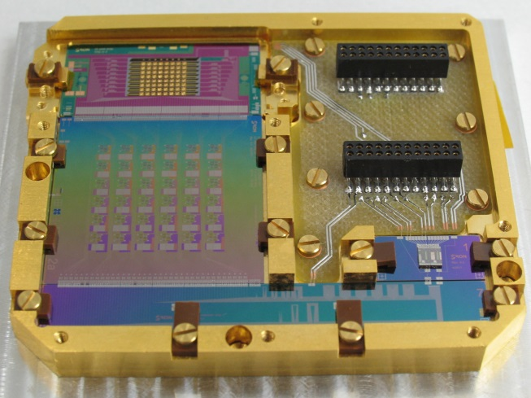
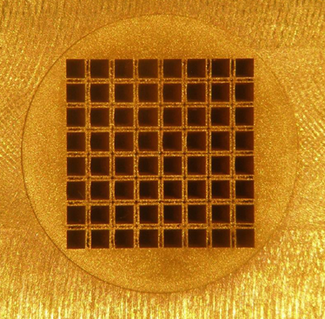
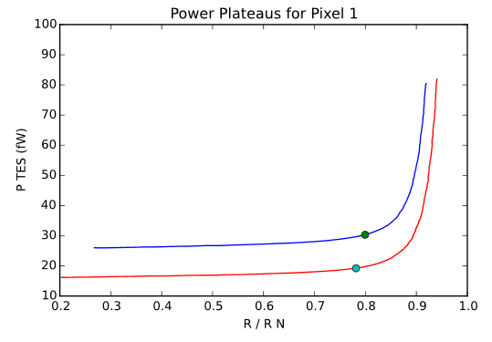
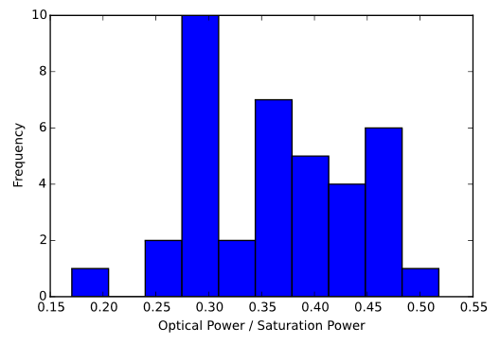
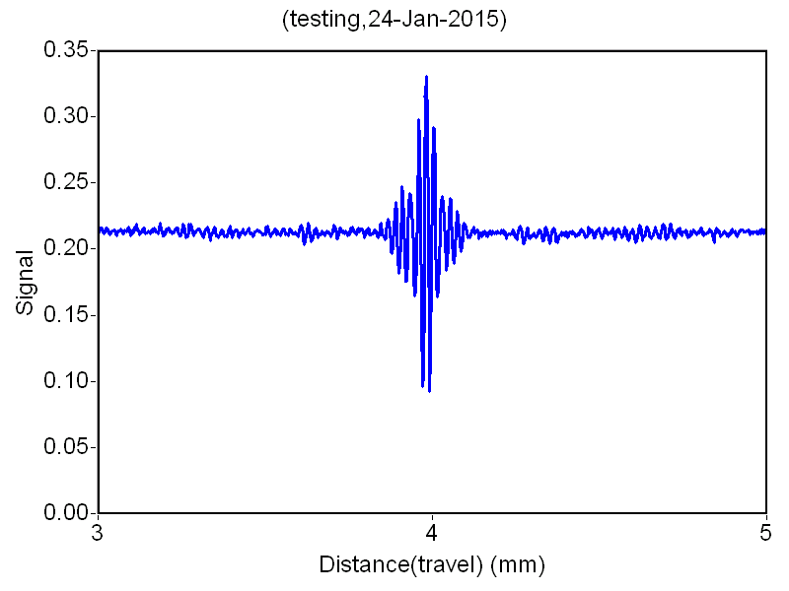
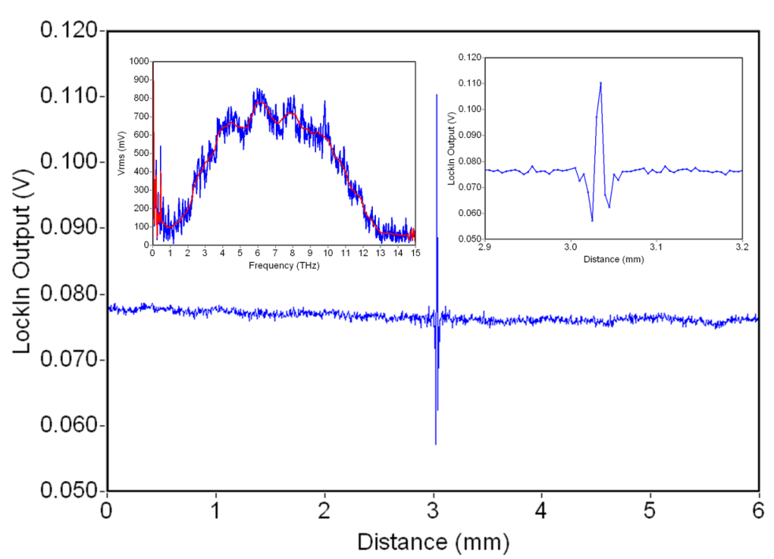
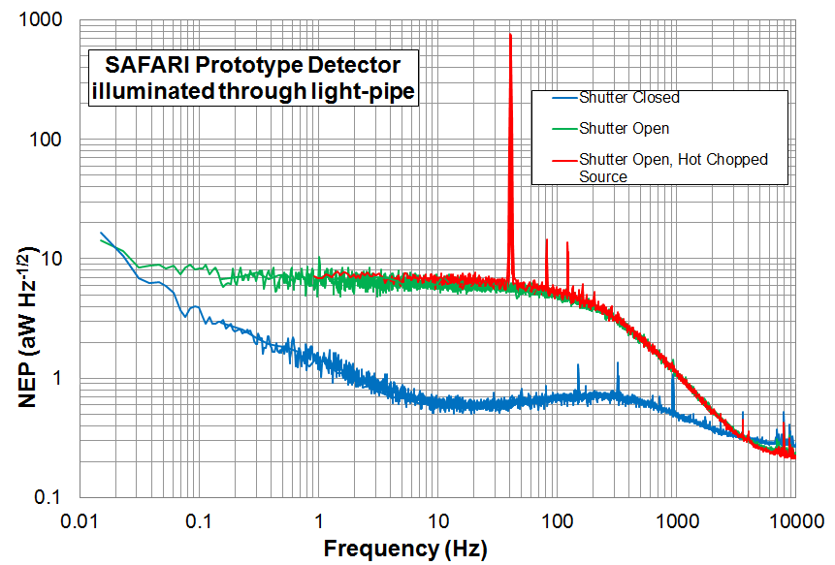
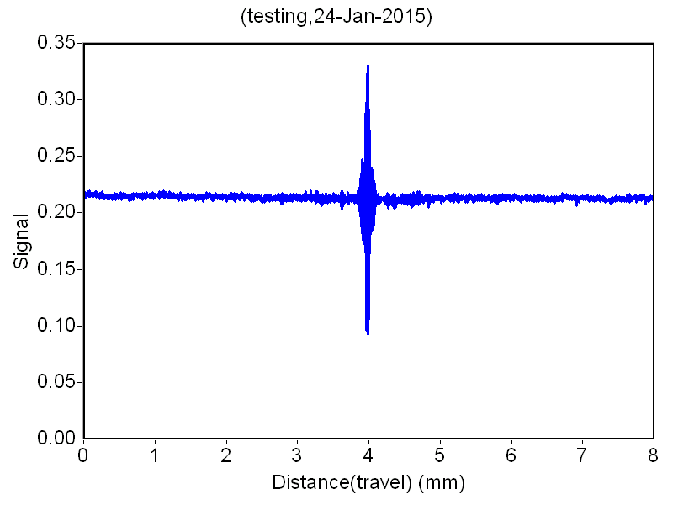
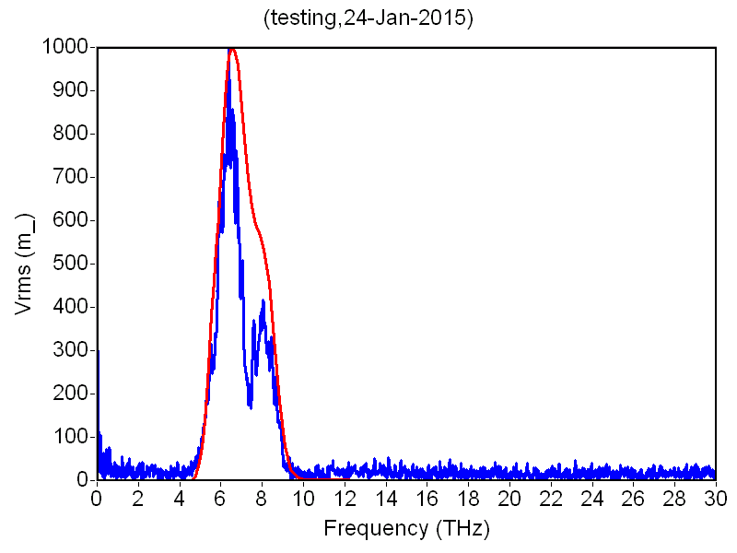
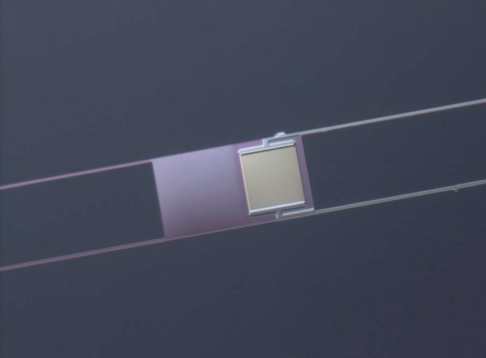
Optical Response of TES Bolometer Arrays for SAFARI
Introduction
SAFARI/SPEC is a far-infrared grating spectrometer for the proposed Japanese SPace Infrared telescope for Cosmology and Astrophysics (SPICA). SAFARI will cover the wavelength range 34—230 µm with a spectral resolution R~300 using four diffraction-grating modules populated with ultra-sensitive TES bolometers. These require a dark NEP≤2×10⁻¹⁹ W/√Hz to take advantage of SPICA's cold (<8 K) telescope. A Martin-Puplett interferometer can be inserted in the beam before the grating modules, providing a high-resolution mode with R varying from ~1500 at 230 µm to ~11000 at 35 µm. At SRON we have already fabricated TES bolometers that are twice as sensitive as required. Testing such sensitive detectors is challenging, particularly because a background power of only a few fW will saturate them. We have therefore built up a unique ultra-low background optical test facility based on a mechanically cooled dilution refrigerator, paying careful attention to magnetic shielding, EMI immunity, and light-tightness. We have verified that the optical efficiency (60%) of prototype detectors for SAFARI's short-wave band meets the requirement. We are now measuring the spectral response of prototype SAFARI detectors using an external optical source and a Michelson interferometer. These measurements are important to ensure that we can measure the dispersed grating spectrum accurately. Furthermore, they allow us to investigate the effects of the intrinsic properties of the TES bolometers (e.g. load-dependent time constant and responsivity) on the extracted interferogram spectra.
Damian Audley, Gert de Lange, Jian-Rong Gao, Richard Hijmering, Pourya Khosropanah, Marcel Ridder, Neil Trappe
Optical Calibration Sources
Reflective Summing Cavity; Lightpipe comes in at back
Hot illuminator
(~300 K)
Reference detector
Cold illuminator
(3-35 K)
Cold
Light-pipe
(450-μm diameter)
Light-tight magnetic
shield
Detectors go here
Detectors see large, cold source and hot point source
Prototype Detectors for SAFARI’s Short-Wave Band (34—60 µm)
Ta absorber
200x200 μm
Ti/Au TES on silicon nitride island
Hemispherical Backshort
500-µm diameter
Measured devices with dark NEP as low as 6×10⁻¹⁹ W/√Hz;
T_{c}~100 mK; P_{sat}~10 fW.
SAFARI Detector Test facility
Measurements of Prototype Array with Internal Black-Body Source
8x8 array with rectangular feedhorns.
Illuminated by large-aperture BB source
Measured under AC bias
with f_{LC} = 1—3.5 MHz
Every pixel detected light.
No TES was saturated.
Cryogen-free dilution refrigerator.
A chopped hot source and FTS in front of the window enable us to measure the spectral response of TES bolometers.
Lightpipe attenuation is ~10⁶
=> a few fW reaches detector
Reference detector : Dual-transition TES bolometer with absorbing film, suspended in absorbing cavity
=> has flat spectral response
=> measures spectral content of injected light
Internal hot and cold black-body sources for optical efficiency measurements; see Audley et al., Rev. Sci. Inst. 87, 043103, 2016 (arXiv:1603.07944)
Window
300 K
Missing pixels:
some are calibration resistors, others
are not connected
Lightpipe
50 K
Cold Shutter
3 K
6.72mm
700 mK
150 mK
- T_{BB} = 3 K
- T_{BB} = 22 K
Light-tight Magnetic Shields
20 mK
Reference Detector
Measurements of Single Pixel with External Optical Source and Michelson Interferometer:
Photon noise from external illumination:
This is the most sensitive detector measured optically in the 30—60-µm range
Step-and-integrate scan took about 2 hours
Step size 2.5 µm
Dark NEP 5—6×10⁻¹⁹ W/√Hz
T_{c} = 84 mK
Dark NEP 5—6×10⁻¹⁹ W/√Hz
T_{c} = 84 mK
Reference Detector
Notes:
PE-54 Optical Response of TES Bolometer Arrays for SAFARI
Michael Damian Audley1, Gert de Lange2, Jian-Rong Gao3, Richard Hijmering4, Pourya Khosropanah5, Marcel
Ridder6, Neil Trappe7
1SRON Netherlands Institute for Space Research, 2SRON Netherlands Institute for Space Research , 3SRON Netherlands
Institute for Space Research / Kavli Institute of Nanoscience, Delft University of Technology , 4SRON Netherlands Institute
for Space Research , 5SRON Netherlands Institute for Space Research , 6SRON Netherlands Institute for Space Research ,
7Maynooth University
We report on the optical testing of ultra-sensitive prototype horn-coupled bolmeter arrays for SAFARI, the grating
spectrometer on board the proposed SPICA satellite. SAFARI's four bolometer arrays, coupled with a diffraction
grating and Martin-Puplett Fourier Transform Spectrometer (FTS), will make spectroscopic observations of the cold,
dusty Universe over the wavelength range 34 􀀀 􀀀230 m.
Each of SAFARI's prototype bolometers consists of a Ti/Au transition edge sensor (TES), with a transition
temperature close to 100 mK, and a tantalum absorber on a thermally-isolated silicon nitride membrane. The nitride
membrane sits behind a few-moded feedhorn and in front of a hemispherical backshort. SAFARI requires extremely
sensitive detectors (NEP < 2 10􀀀19 W=
p
Hz), with correspondingly low saturation powers, to take advantage of
SPICA's 6-K cooled optics.
We have measured the optical efficiency of prototype detectors for SAFARI's short-wave band (34􀀀􀀀60 m) and
used an external FTS to explore the effects of non-linearity and saturation on their spectral response. We present our
latest measurements of the optical response of prototype arrays, compare them with simulations, and discuss them in
terms of the instrument performance.
category : Applications

