Slide 1
Enhanced Calorimetry Using
Helium Evaporation and Field Ionization
George Seidel, Derek Stein, Humphrey Maris
Brown University

Slide 2
old ideas applied to a new problem
problem:
direct search for light mass WIMPs
low mass limit set by threshold energy
old ideas:
particle detection in superfluid helium via evaporation – LTD1 (1987)
helium evaporation from solid surfaces by phonons – Lennard-Jones (1935)
Goodstein, et al. (1980’s)
field ionization of helium – Müller (1951)

Slide 3
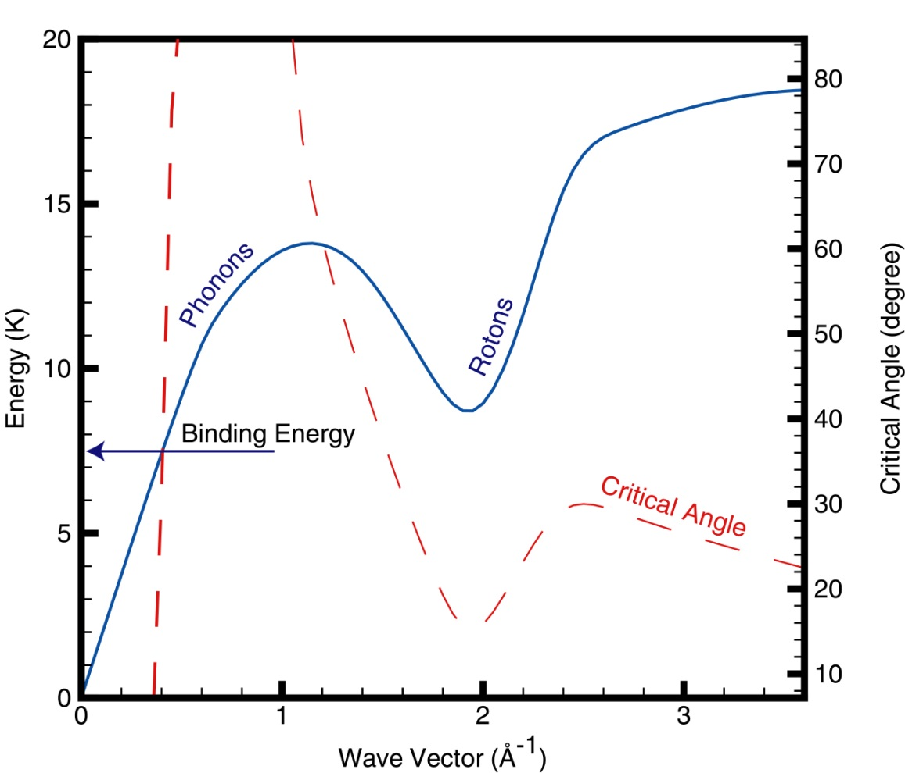
quantum evaporation from superfluid helium
binding energy of He to itself is 7.16 K (.618 meV)
quasiparticles stable for 8 K < E < 17 K
quantum evaporation: 1 to 1 process; quasiparticle to evaporated He atom
(Balibar, Wyatt)
kinematic constraints
conservation of E and p_{parallel}
vapor density: 1.5×10²¹ T^{1.5}e^{-7.16/T} /cm³
at 100 mK n≈ 4×10⁻¹² /cm³
at 50 mK n≈ 1×10⁻⁴³ /cm³
saturated film ∼ 200 Å thick
roton/roton scattering ∼10⁻¹⁴ cm²
roton/³He scattering ∼10⁻¹⁵ cm²
ENERGY DEPOSITION OF LESS THAN
1 meV CREATES A HE ATOM IN VACUUM

Slide 4
particle detection using quantum evaporation
HERON 1987- 1999
measure pp solar neutrinos by energy deposition from electron recoils
detect evaporated He atoms (and UV scintillation) using array of
calorimeter/wafers above liquid surface
demonstrated technical feasibility but did not proceed to large scale detector
calorimeters
adsorption on film free wafer (requires film burner)
film has large heat capacity
binding energy to solids: 3 to 6 meV; gain of ∼10
evaporation principally from rotons above minimum
from angular dependence and density of states
only 5% within critical cone; 50% prob. of evap.
2.5% yield
another ∼5% from after reflections from solid surfaces
present threshold for large area calorimeter ∼300 atoms
projection to 10 atoms
50º
liquid helium

Slide 5
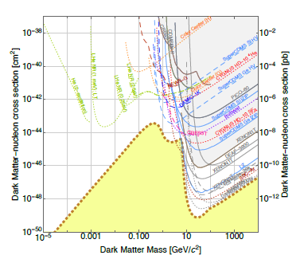
exclusion plot
from
US Cosmic Visions
white paper
arxiv1707.04591

Slide 6
application to solids
crystals with long phonon mean free path
energetic phonons propagate and undergo anharmonic decay: rate ∼E⁵
for E ∼ 10 meV ballistic propagation
coat surface with several layers of helium
(unsaturated film) at third layer binding energy
is within few percent of bulk value
desorption of helium observed for longitudinal
and transverse phonons (Goodstein, coworkers)
coat surface with material having low binding energy for helium,
helium on cesium: ⁴He – .33 meV; ³He – .16 meV
then monolayer of helium
can use molecular hydrogen in place of helium
desorption by phonons has been observed
penalty of ∼10 meV binding energy, advantage of working at 1K
application to coherent neutrino-nucleus scattering

Slide 7

field ionization
E. W. Müller 1951
sharp tip; apply a potential such that at the tip the field is ∼ 50 V/nm
electron tunnels from atom into metal
positive ion accelerated to cathode
potential required depends on radius of tip
for R of 10 nm, field enhancement of ∼1000
(depends on height of shank)
energy of electron attached to He atom
relative to Fermi level in metal
E = φ - I_{p} + F e x - e²/(16π ε₀x ) - ½ α F²
x_{c} $≅$ (I_{p} - φ )/F e
ionization potential: I_{p} = 24.6 eV for He; work function φ = 4.5 eV for W
ΔV
I_{p}
φ
CB
x_{c}

Slide 8
field ion microscopy

Slide 9
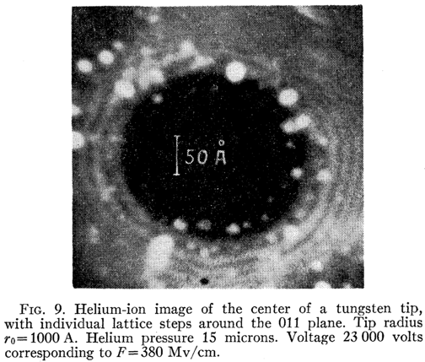
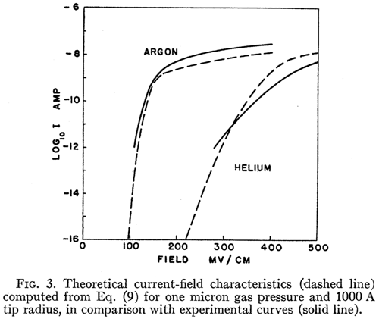

size of ionization zone
ionization with low pressure He gas at RT
ionization occurs below 20 V/nm but rate is low
at 45 V/nm from kinetic theory
use current to define
radius of effective ionization zone
$I ≅(\frac{1}{4}$nv) 4π$R_{}^{2}$_{eff} e
R_{eff} ≈ 450 nm
for tip R ≈ 100 nm
E.W. Müller and K. Bahadur, Phys. Rev. 103 p. 624-631 (1956).

Slide 10
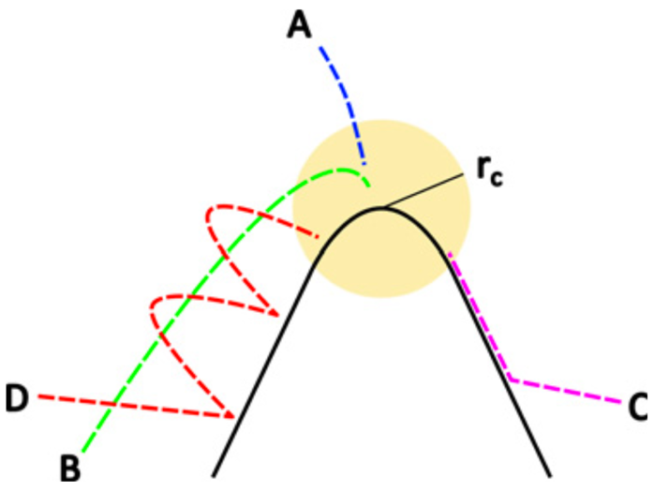
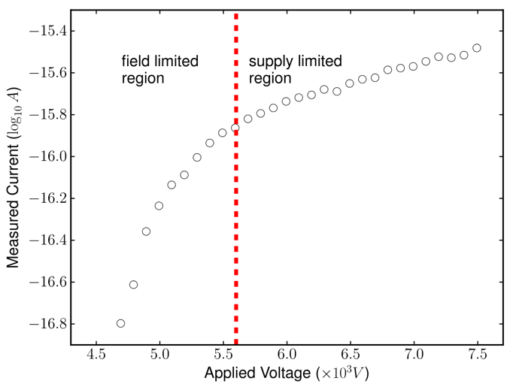
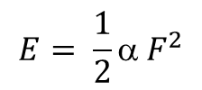
arrival of atoms at tip
Direct impact
Orbital capture
Surface diffusion
Bouncing
$$E= \frac{1}{2}α F^{2}$$
The polarization force draws helium to the tip, where the field gradient is highest.
K.M. O’Donnell, A. Fahy, L. Thomsen, D.J. O’Connor and P.C. Dastoor, Meas. Sci. Technol. 22 015901 (2011).

Slide 11
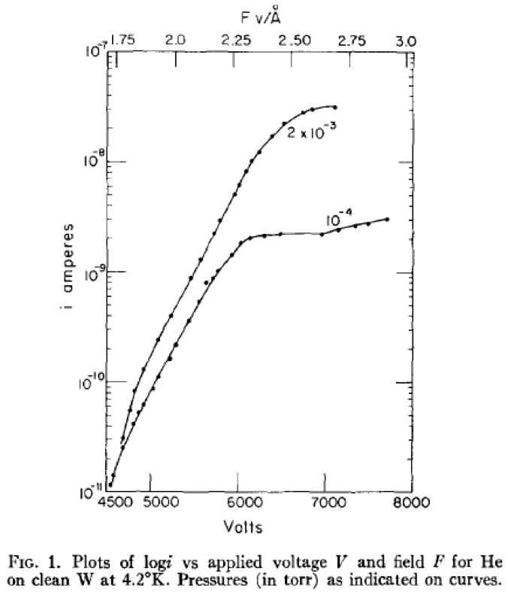
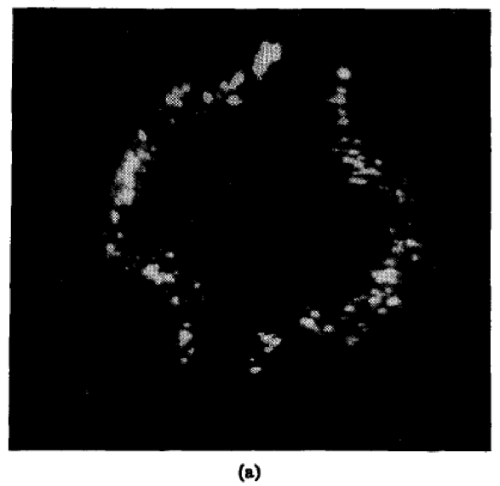
field ionization of helium at low temperature
cold surfaces deliver He to the tip.
field ionization works well at 4.2 K.
measured currents reflect ionization at ∼10¹¹ Hz.
B. Halpern and R. Gomer, J. Chem. Phys. 51, p. 5709-5715 (1969).

Slide 12
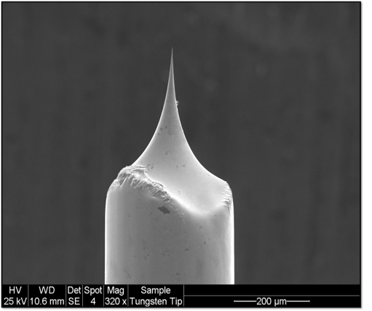
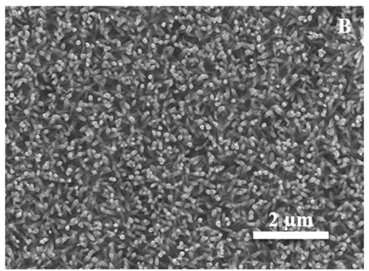
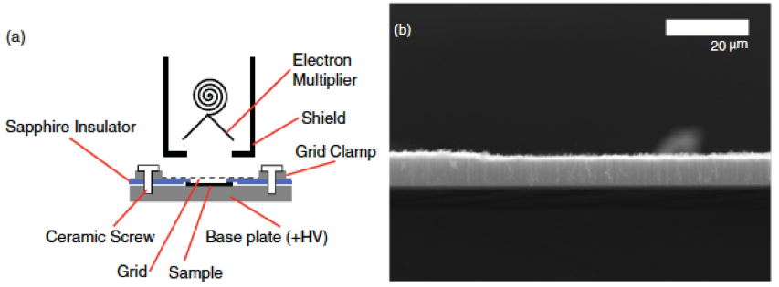
field ionization tips
aligned nanowires
various vapor deposition processes
carbon nanotubes,
doped semiconductors
sharp tips, whiskers on tips
macroscopic areas ∼ cm²
nanowires
carbon nanotubes
electrochemically etched tungsten
W.C. Lee, Y. Fang, J.F.C. Turner, J.S. Bedi, C.C. Perry, H. He, R. Qian, Q. Chen, Sensors and Actuators B 237, p. 724–732 (2016).
K.M. O’Donnell, A. Fahy, M. Barr, W. Allison, and P.C. Dastoor, Phys. Rev. B 85, 113404 (2012)

Slide 13
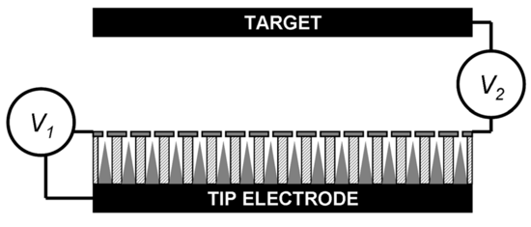
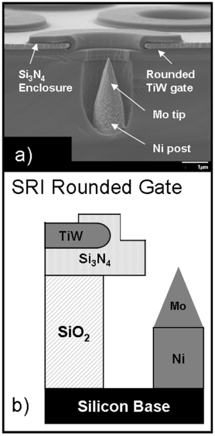
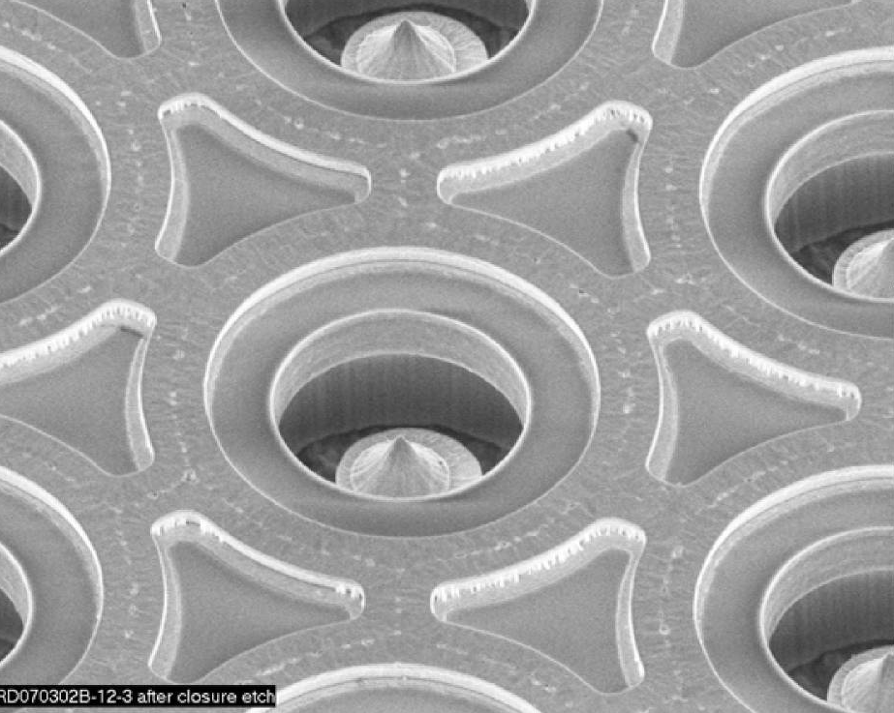
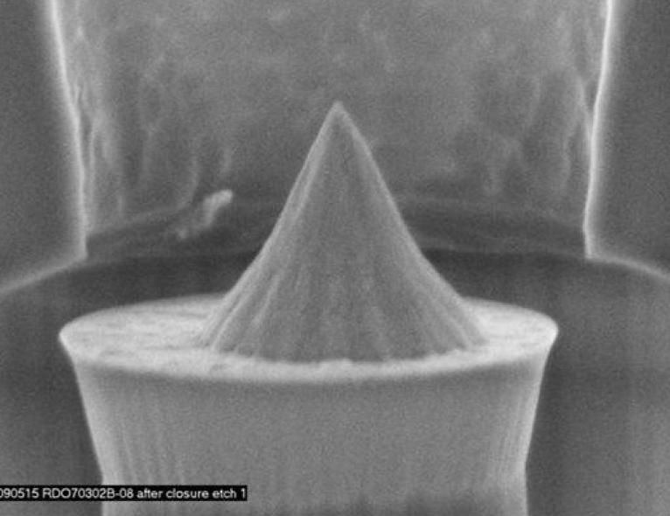
more tips
doped semiconductors require lower fields
field penetration and band bending
unoccupied surface states
expressed in terms of field enhancement > 10⁴
electrode spacing ∼ 1.5 μm,
∼ 100 V potential
B. Bargsten Johnson, P. R. Schwoebel, P. J. Resnick, C. E. Holland, K. L. Hertz, and D. L. Chichester, J. Appl. Phys. 114, 174906 (2013).

Slide 14
chevron configuration
Field ionization detector array
50º
liquid helium

Slide 15
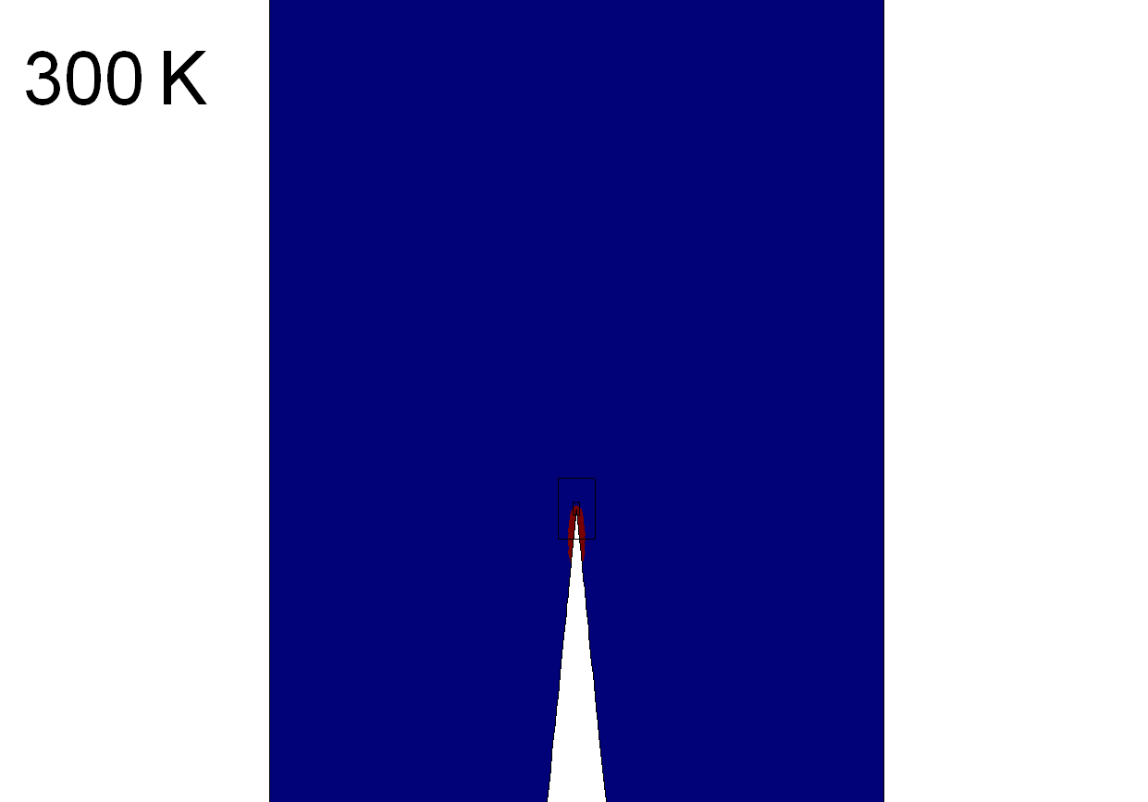
field ionization detector array
Red region:
calorimeter
D
~10a
a

Slide 16
noise and dark counts
if He⁺ ion hits cathode with ~ 10 keV
secondary electrons
25% probability of emission
accelerated back to anode tip; 1% probability of bremsstrahlung
probability of emission relatively constant for E < 1 keV, decreases for E > 1 keV
sputtering
20% probability from beryllium surface
beryllium ionized at anode tip; 20% probability of sputtering at cathode
probability of sputtering decreases for both E < and > ∼ few keV
field emission of electrons from cathode - protuberances
Cu and SS unusable; Mo and Nb good at 500 keV/cm
problem not with electron emission or sputtering per se but what follows upon interacting with anode tip

Slide 17
summary
quantum evaporation from liquid helium extensively demonstrated
efficiency need to be determined
He evaporation from crystalline solids observed
efficiency requires investigation
calorimetric detection of evaporated atoms assured
threshold level can be improved
field ionization of helium is well studied
efficiency of single atom detection unknown
design of ionizer an open problem
noise sources need identification and possible mitigation
facilitate dark matter search down to a mass of ∼1 MeV/c²
applicability to other calorimeter experiments requiring large mass??

