Slide 1
The 30th aniversary of LTD
Low Temperature Detectors
( for Neutrinos and Dark Matter )
30 Years ago,

Slide 2
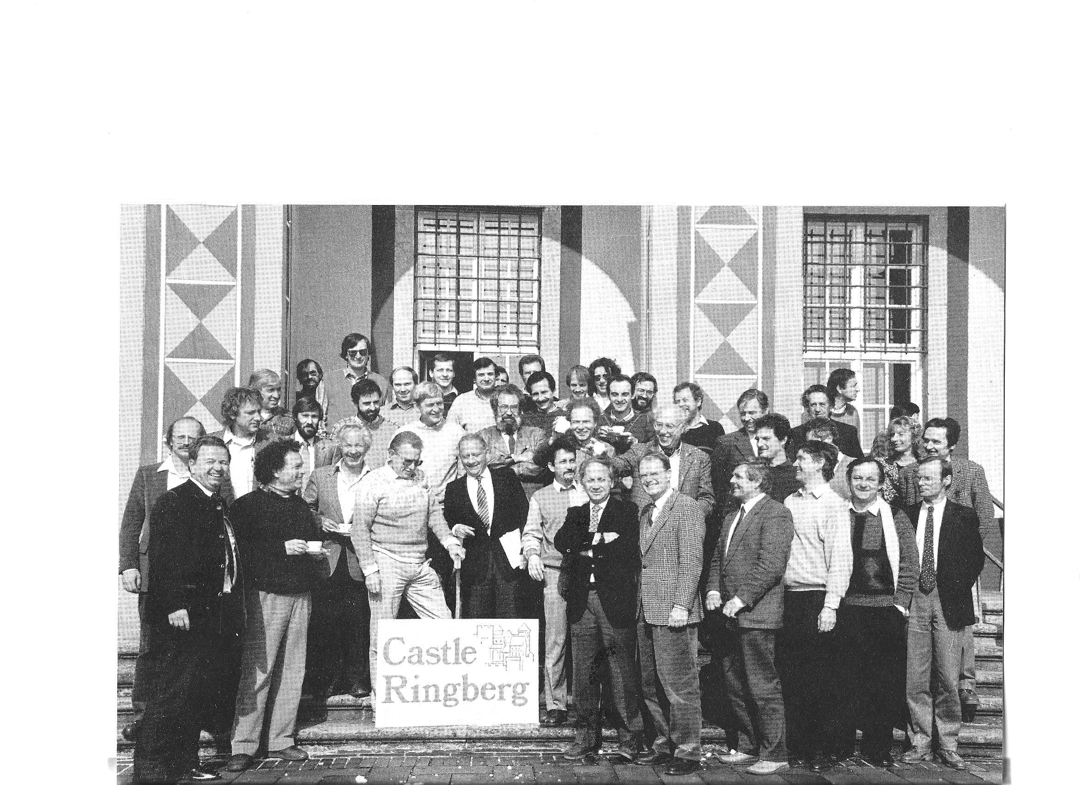
LTD 1 Ringberg Castle 1987
L.Stodolski
E.Fiorini
W.Seidel
T. Niinikoski

Slide 3
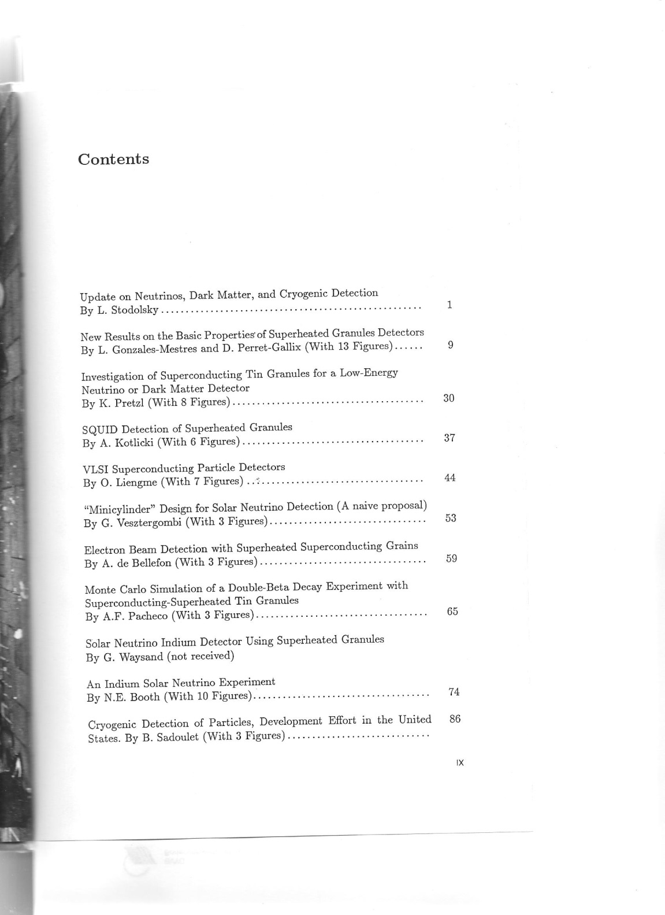
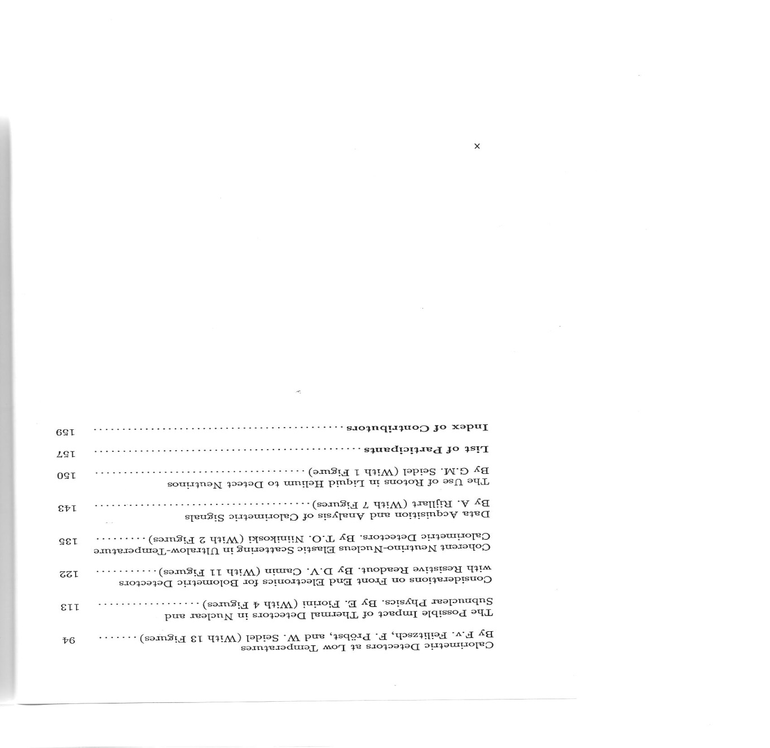
LTD1 Ringberg Castle

Slide 4
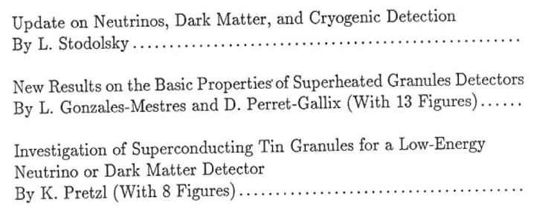
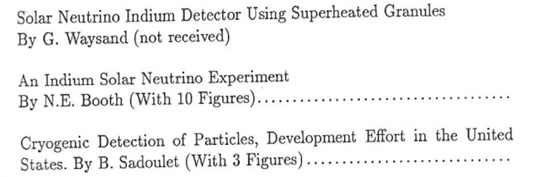

Slide 5
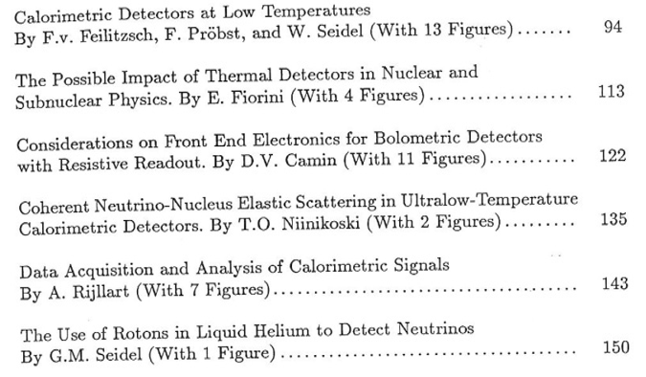

Slide 6
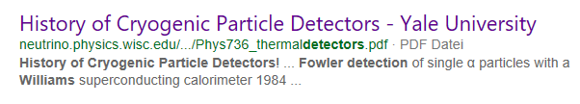
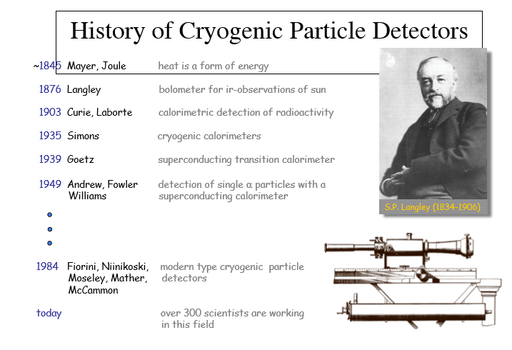
T.Niinikoski
Wisconsin 2010

Slide 7
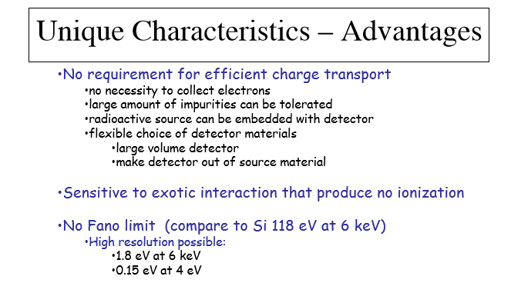

Slide 8
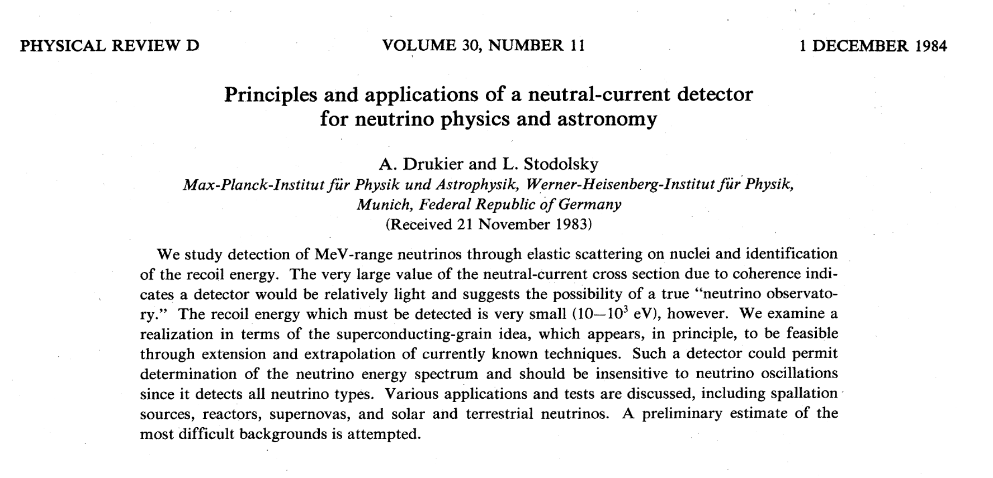
Cryo detectors for coherent neutral current scattering off nuclei
Applications: spallation source
reactor-
Supernova-
Solar
terestrial - neutrinos
1984

Slide 9
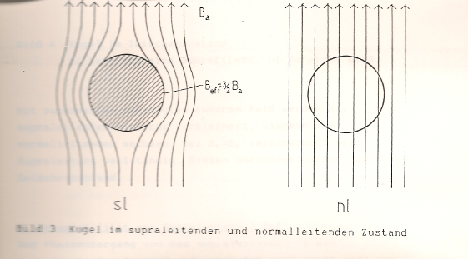
Metastabel suoerconducting grains
In magnetic field
Sensitiv to energy deposition of 1-100eV ?
Super conducting
Normal conducting
Detection of grain flip via magnetic inductance

Slide 10
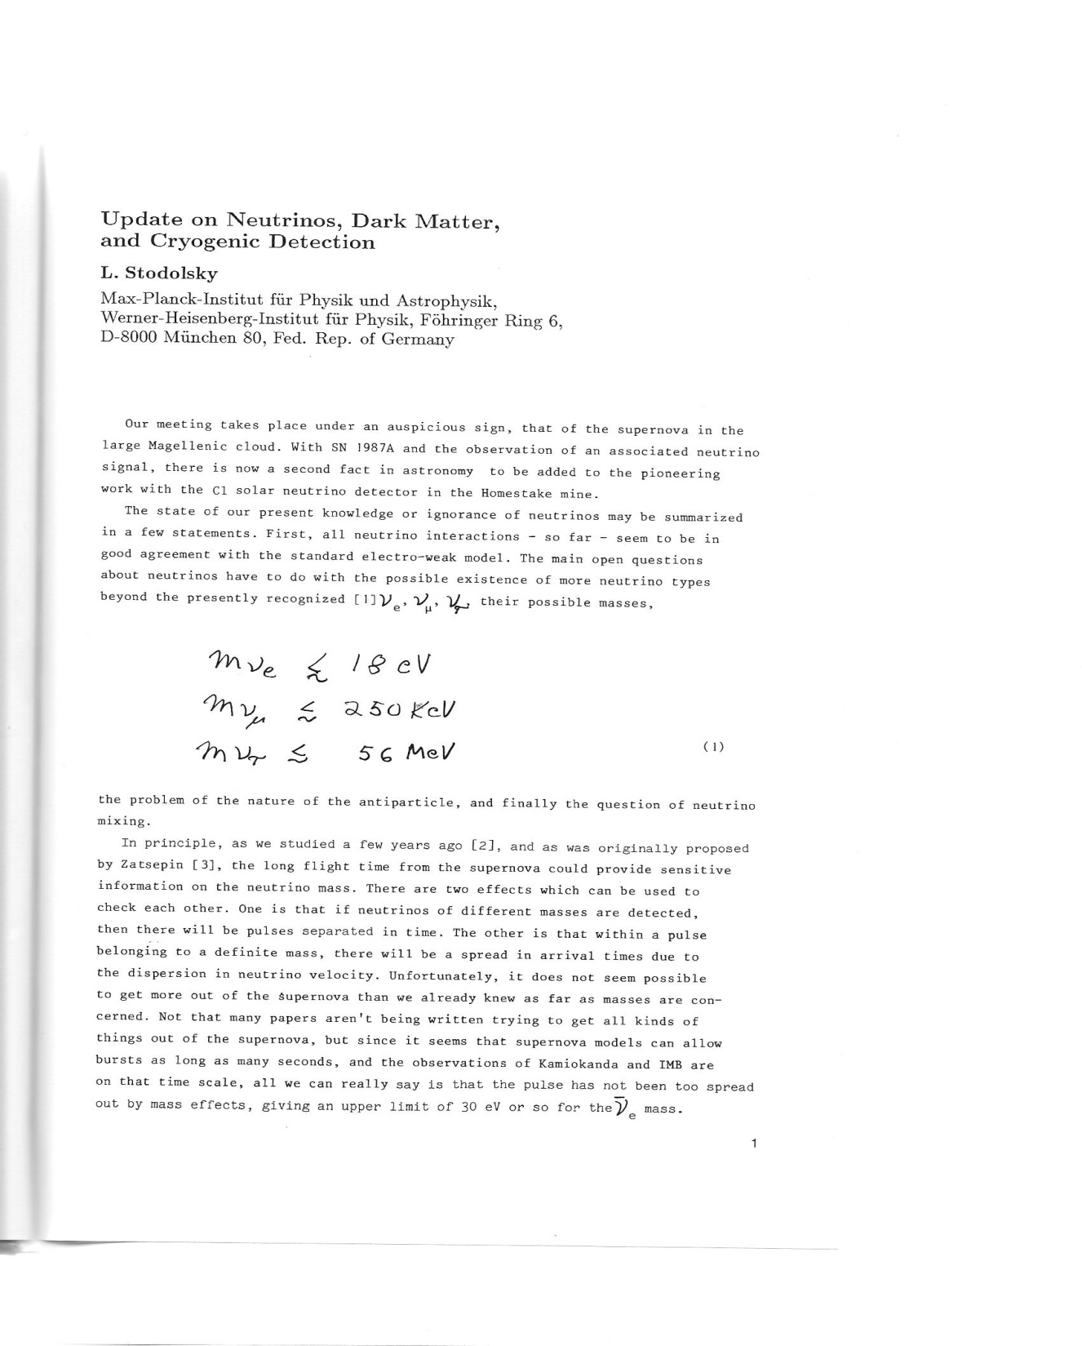
Supernova 1987a
V- signal detected
From SN1987a
mv < 30 eV

Slide 11
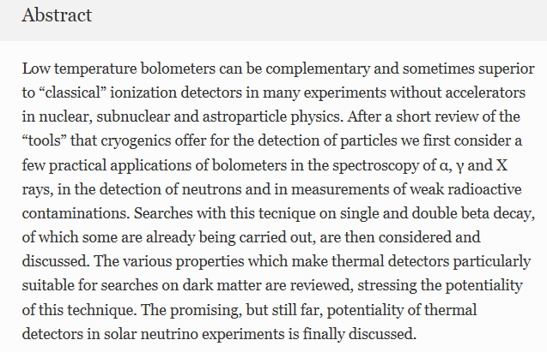
1993
Alpha
Beta
Gamma
X-rays
Darc matter
ßß0v decay
ß endpoint

Slide 12
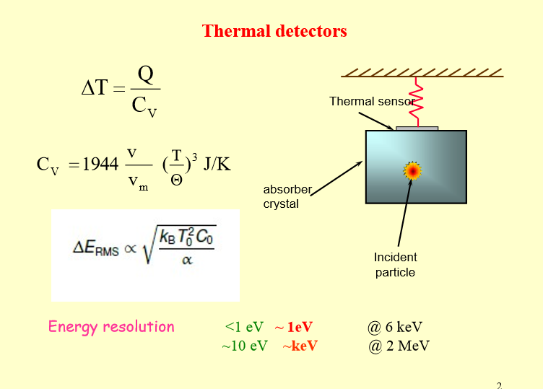
Ettore Fiorini LTD15

Slide 13
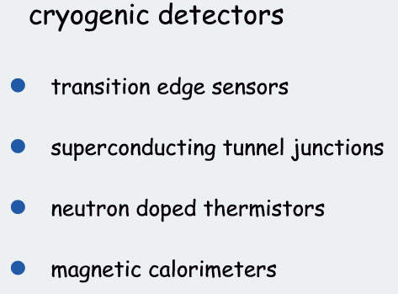
Thermometers

Slide 14
Position sensitiv
Fiducial volume by
techniques
Thermometers
NTD resistive thermometers
TES super conducting Transition Edge Sensor
MMC Magnetig Micro Calorimeter
Hybrid calorimeters
Heat- ionisation
Heat- scintillation light
Fiducial volume by
Electric field distribution
active housing

Slide 15

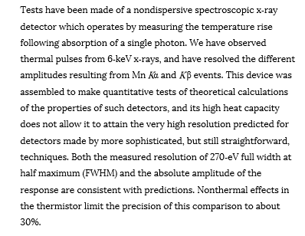
Systematic test of thermal
detectors, test of theoretical
Calculations
D. Mc Cammon
1984

Slide 16
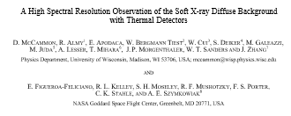
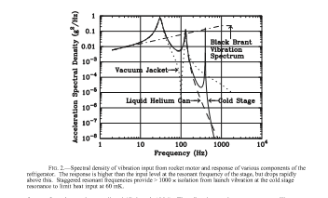
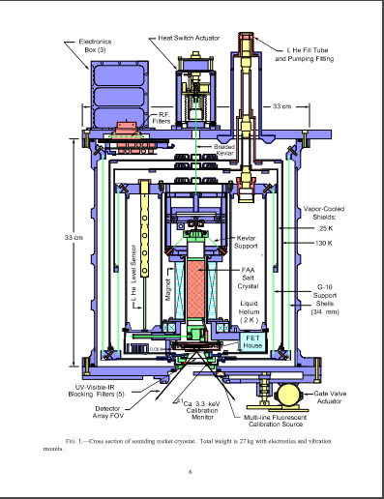
Construction and flights late 1980th

Slide 17
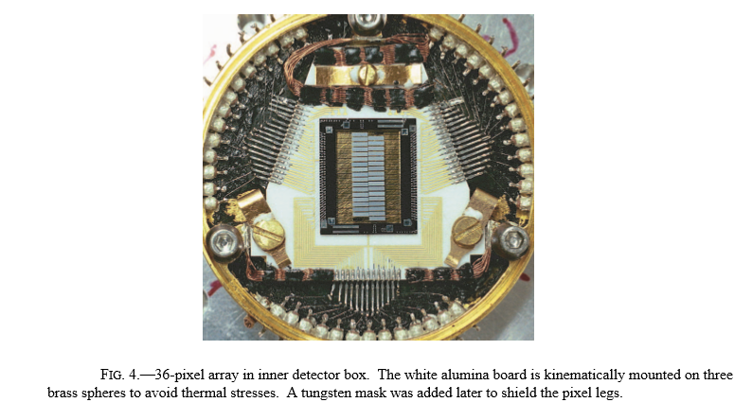
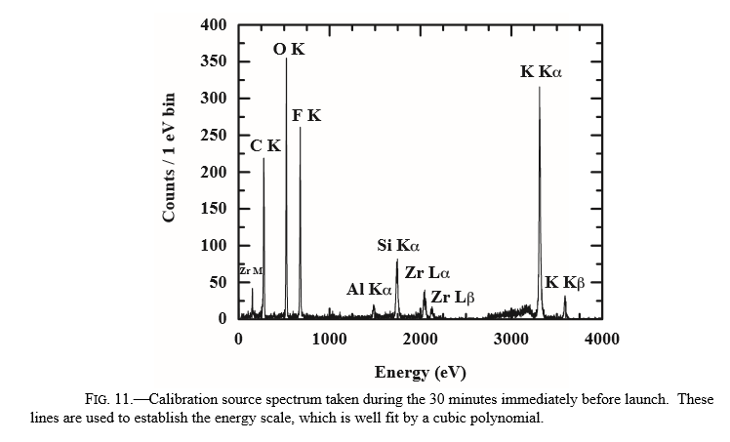

Slide 18
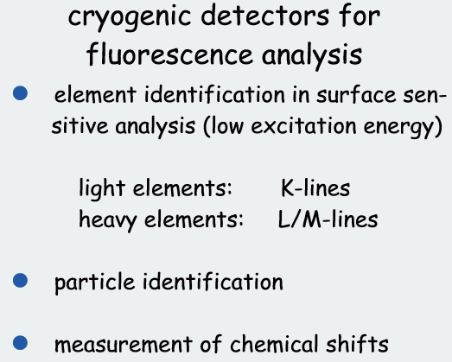

Slide 19
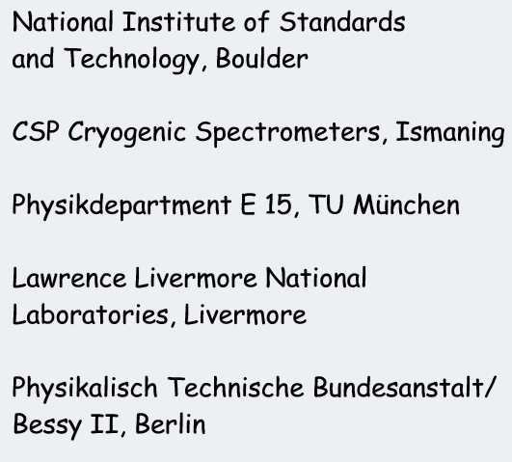
G. Angloher 2001

Slide 20
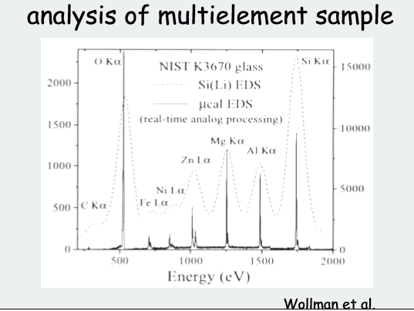
G. Angloher 2001

Slide 21



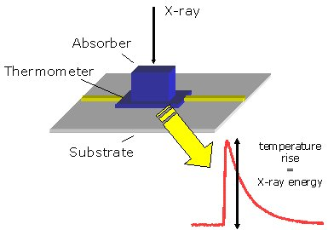
EDS with Microcalorimeters
2006
C. Hollerith¹, M. Bühler³, F. v. Feilitzsch¹, J. Höhne³,C. Isaila, M. Huber¹,J. Jochum¹, K. Phelan³, B. Simmnacher², R. Weiland², D. Wernicke^{1,3},
1:Physik-Department E15, TU München, James-Franck-Straße, 85747 Garching
2: Infineon Technologies AG, Otto-Hahn-Ring 6, 81739 München
3: VeriCold Technologies GmbH, Bahnhofstr. 21, 85757 Ismaning
Usage of Microcalorimeters on Scanning Electron Microscopes (SEM) for determination of elemental constitution of samples

Slide 22
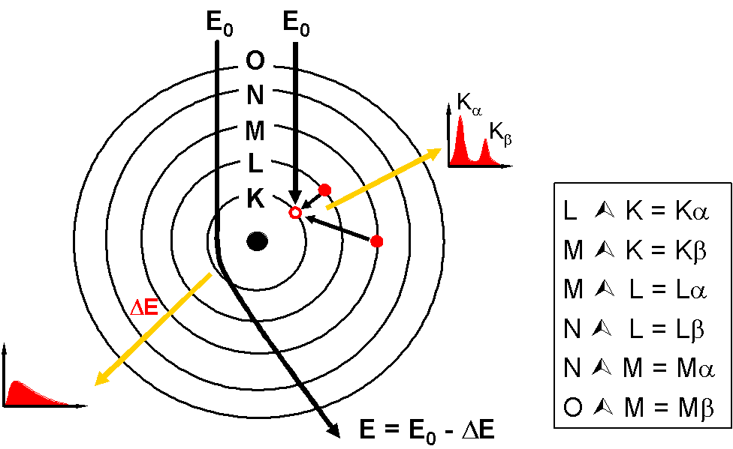
What is
Energy
Dispersive X-Ray
Spectroscopy?
incident electron beam
X-rays
Si(Li), cryogenic detector
sample
Measurement of characteristic X-ray energy in SEMs (scanning electron microscopes)
Information on elemental constitution of sample

Slide 23
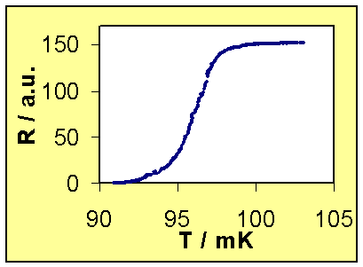
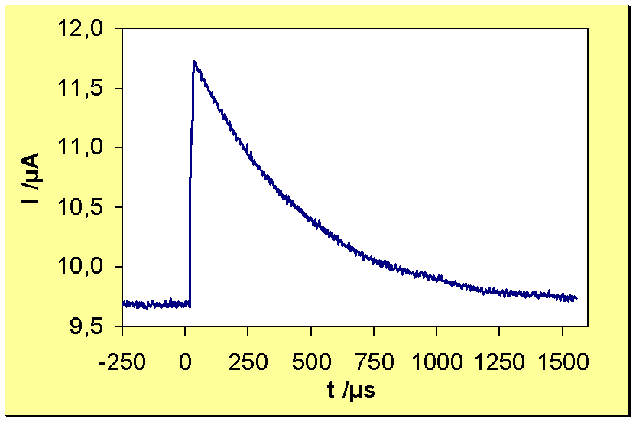
Setup / Principle of Microcalorimeter
X-ray
Aperture
(200µm x 200µm)
SiN-
membrane
Au - Absorber (250µm x 250µm x 0.5µm)
Ir/Au - Thermometer (400µm x 400µm)
I_{O}
SQUID
Δ R
L
ΔT
R_{S}
R_{detector}
Detector response
at absorption of a X-ray
Transition Ir/Au proximity- film
Read out circuit

Slide 24
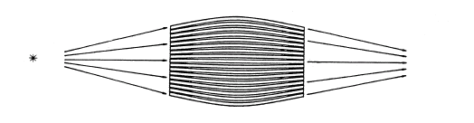
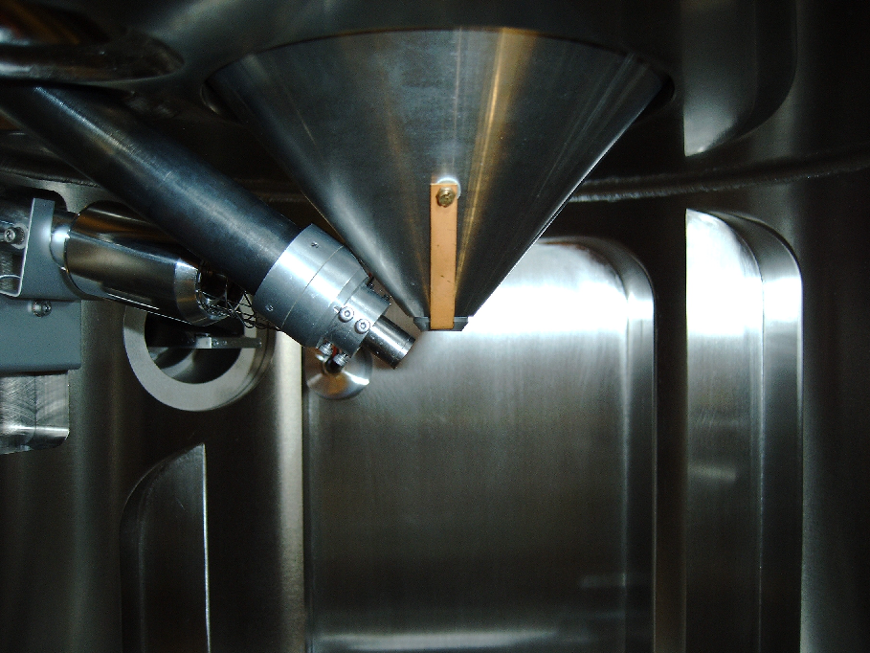
Countrate
Installation of a polycapillary lens
Increase of solid angle due to greater area (A=12 mm²)
and lower distance (d=9 mm)
Snout with lens in SEM
Working principle:
thin, curved glass capillaries form two focal spots on sample and detector

Slide 25
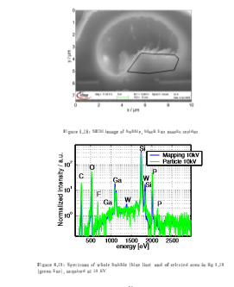
EDS element identification on electron microscope picture

Slide 26
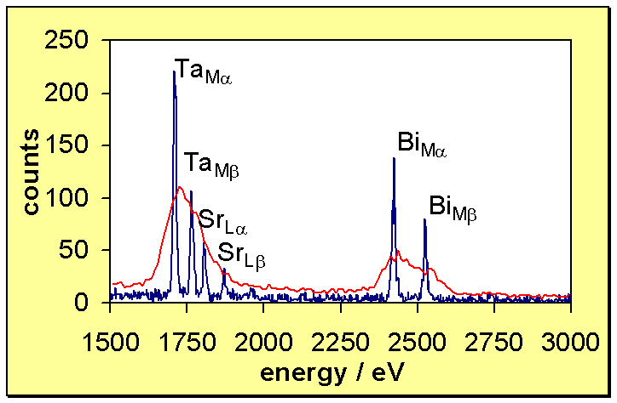
Anwendungsbeispiele: Dünne Schichten
Analyse dünner Schichten
Probe: SrBi₂Ta₂O₉ (SBT) / Pt / TiO₂ / SiO₂ / Si -Substrat
5 keV
Elektronenstrahl
180 nm SrBi₂Ta₂O₉
100 nm Pt
10 nm TiO₂
625 nm SiO₂
Si-Substrat
Spektrum @ V_{acc} = 5 keV

Slide 27
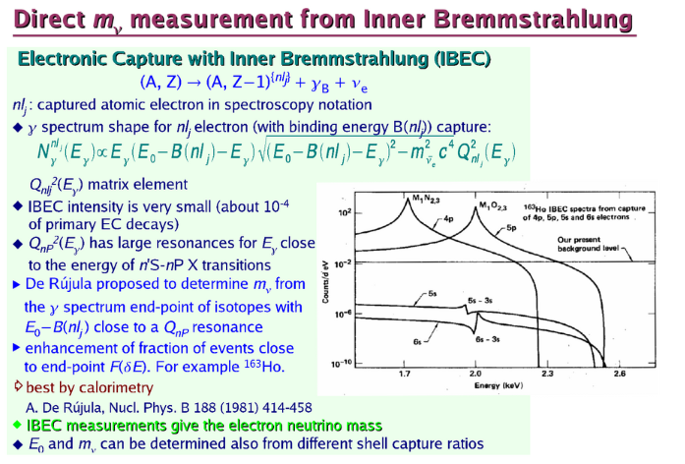
Neutrino physics
Neutrino mass,
Paricle-antiparticle identity ßß0v decay
resonance
A. De Rujula
1981

Slide 28
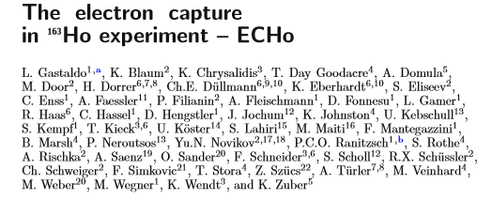

Direct search for neutrino mass
3 proposals for 163 Ho exp
ECHo, Holms (2015), Numecs (2014)

Slide 29
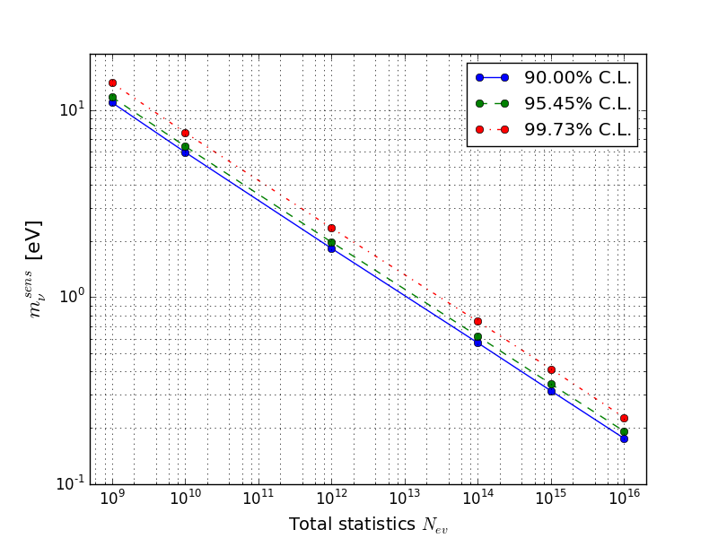
ECHo and the electron neutrino mass
e⁻
e⁻
n
p
p
p
n
p
n
e⁻
e⁻
e⁻
n
p
e⁻
n
p
n
p
n
e⁻
e⁻
e⁻
Statistics in the end point region
N_{ev} > 10¹⁴ → A ≈ 1 MBq
Precision characterization of the endpoint region
ΔE_{FWHM} < 3 eV
Unresolved pile-up (f_{pu} ~ a ⋅ τ_{r})
f_{pu} < 10⁻⁵
τ_{r} < 1 µs → a ~ 10 Bq
10⁵ pixels
Background level
< 10⁻⁶ events/eV/det/day
f_{pu} = 10⁻⁶ ΔE_{FWHM} = 2 eV

Slide 30
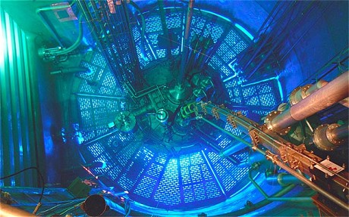
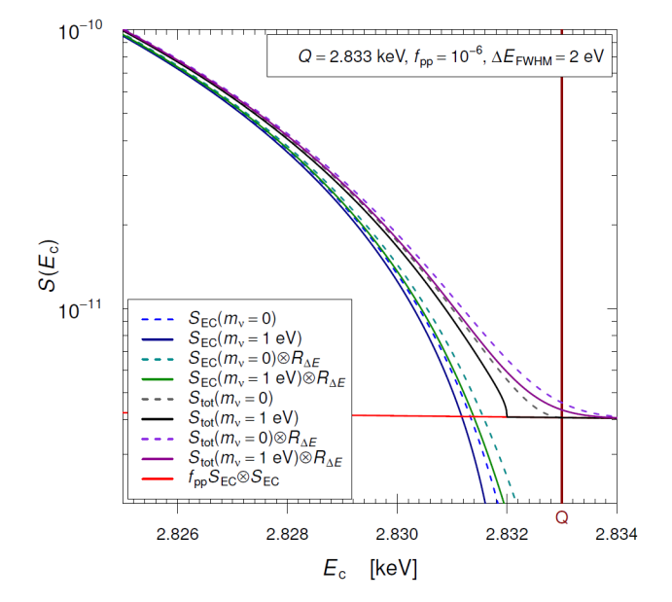
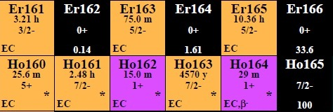
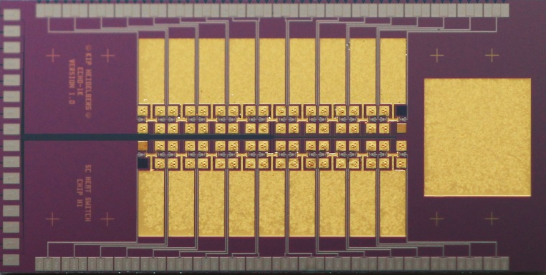

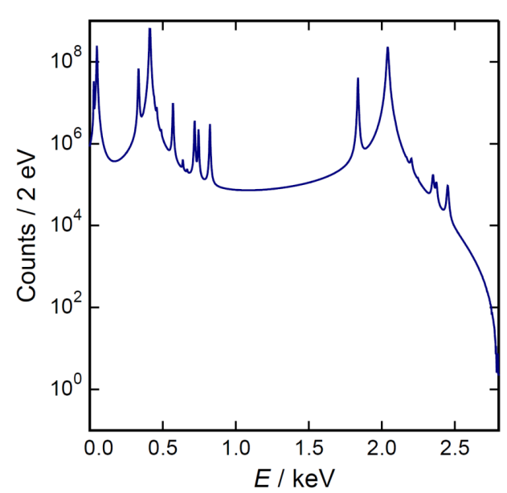
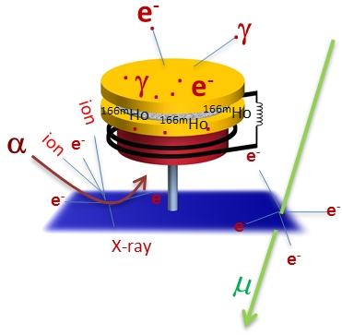
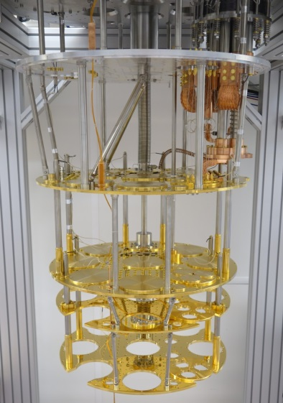
Analysis tools to extract
the electron neutrino mass
High purity ¹⁶³Ho source
production and purification
Microwave SQUID multiplexing for large MMC arrays
Theoretical description
of the ¹⁶³Ho EC spectrum
Dedicated cryogenic platform
Independent
determination
of Q_{EC}
Structures due to higher order excitations
Identification and suppression
of background sources

Slide 31
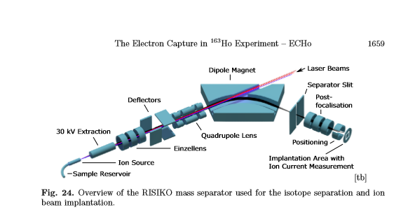
Ion beamimplantation of Ho

Slide 32
Mare 2006 187 Re ß-decay
Mare1 mv < 2 eV 300 detectors
Mare 2 mv < 0,2 ev several 1000 detectors
Sensors: doped Si thermistor
TES Ir/Au multilayer transition edge

Slide 33
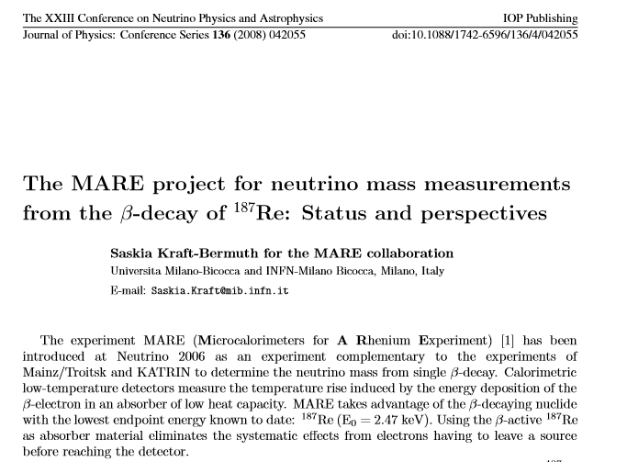
2006

Slide 34
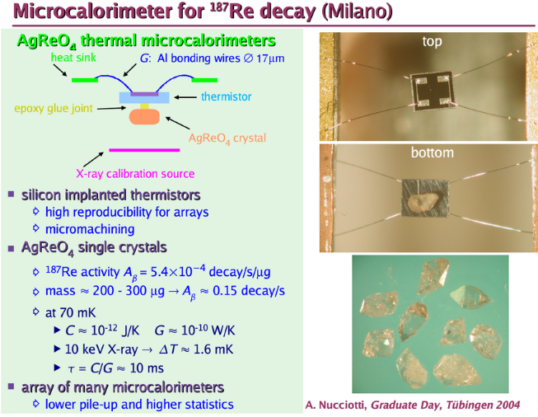

Slide 35
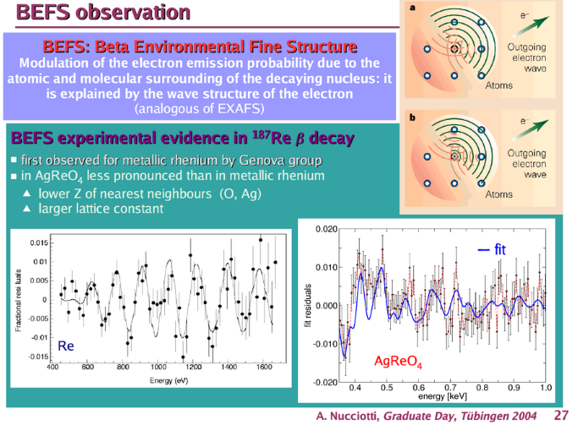

Slide 36
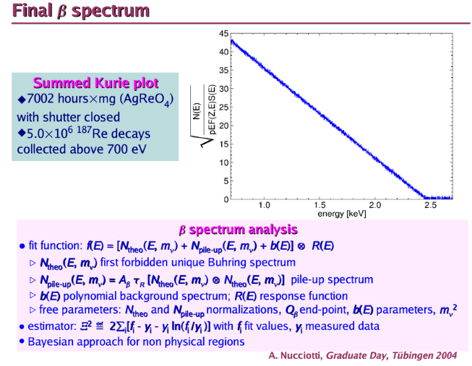

Slide 37
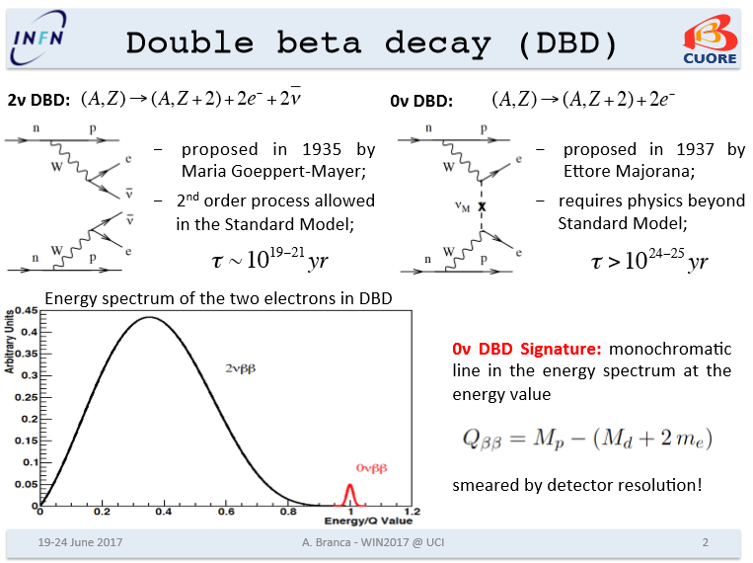

Slide 38
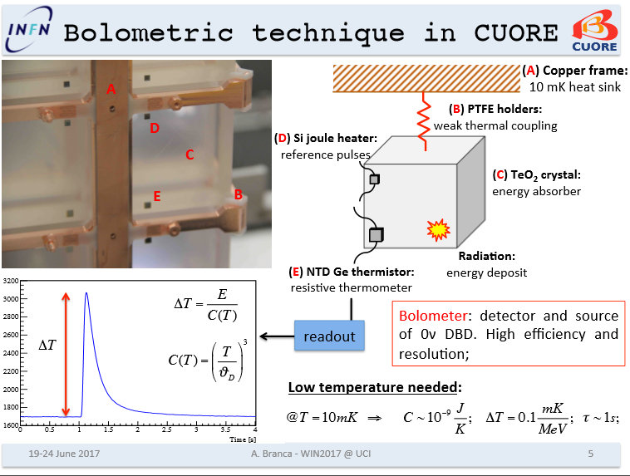

Slide 39
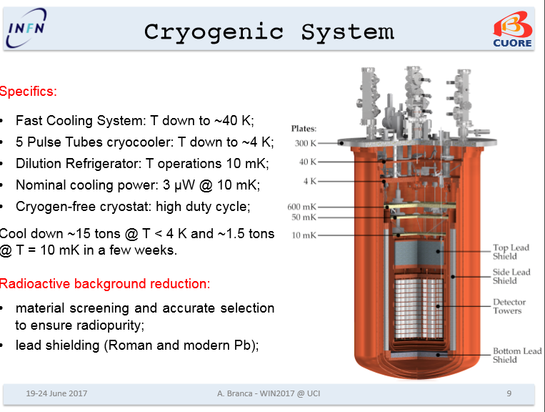

Slide 40


Slide 41

congratulation

Slide 42



Potential of Cryogenic Detectors
for darc matter search
Why are cryogenic detectors particularly sensitive to low-mass WIMPs ?
Low energy threshold
Ge
100 GeV/c²
10 GeV/c²
1 GeV/c²
lower WIMP mass

Slide 43

Raimund Straus

Slide 44

E.Fiorini LTD15

Slide 45


Slide 46

superCDMS at SOW Lab

Slide 47


Slide 48

Charge –heat-position

Slide 49





The CRESST Experiment
Cryogenic Rare Event Search with Superconducting Thermometers
LNGS
Detector “Carousel”
up to 33 individual CRESST modules
CRESST
sala A
CRESST-Testcryostat
truck tunnel

Slide 50



CRESST
280g Al2O3 detector Dr Arb. W. Seidel
First DM Detector^ for CRESST
1989
largest cryodet at the time
Test of energy flow and linearity
Optimized for low WIMP mass: Al, O target

Slide 51




CRESST – Multi-Element Target
Example:
CaWO₄ target
Threshold: 12keV
Cross-section: 1pb

Slide 52


Recent Exciting Progress at TUM
First steps in chemical purification of CaCO₃ powder:
Measurements indicate purification
  Th contamination decreased by factor 2-7
  U contamination decreased by factor 15-35
Crystal growth successful
Two new crystals implemented in CRESST-III phase 1 !
Raw ingot enough for 3-4 CRESST-III detectors
work by H.H. Trinh Thi, A. Münster, A. Erb
30mm

Slide 53


Radiopurity of CaWO₄ Crystals
CaWO₄-crystal production at TU Munich
Unprecedented radiopurity (by factor 2-10)
A. Erb et al., CrystEngComm 15(2013)12
raw ingot of m≈1kg
Average rate:
~3.5 counts / [kg keV day]
Excellent resolution:
𝜎 ≈ 90eV
Threshold:
E_{th} ≈ 603eV
(Nuclear-recoil energy directly measured!)
¹⁷⁹Ta L1(EC)
commercial crystal
TUM-40
²²⁷Ac
²¹⁰Pb

Slide 54

Light
detector
Phonon
detector
F. Probst

Slide 55

Phonon-Light Technique
light
phonon
e⁻/γ
light yield
neutrons
phonon
Reduced light output for highly-ionizing particles Quenching

Slide 56


CRESST-III: Low-Mass Dark Matter Search
Straight-forward approach: CRESST-III Phase 1
Status quo
m = 250g
V = 32x32x40 mm³
Scale down size by factor 10
m=24g
Phonon threshold: E_{th} ≲ 500eV improvement by a factor of 5-10
Light-detector res.: 𝜎 ≈ 5 eV improvement by a factor of 2
F. Pröbst

Slide 57


Slide 58

CRESST-III Phase 2
CRESST-II Phase 2
CRESST-III Phase 2 projection
100 x 24g detectors of improved quality operated for 2 years ≈ 1000 kg-days (net)

Slide 59

Coherent neutrino nucleus scattering
crossection σ ̴ G²/ 4π N² (Eν)²
N number of neutrons in the nucleus
R.Straus

Slide 60


Slide 61

See presentation Raimund Straus this conference

Slide 62

Study of 3 different sites
Medium case (40m)
Straight forward in terms of:
experimental site
signal rate
background level
→ Discovery within 2 weeks

Slide 63
Congratulations to the scientists working in the field
LTD 1: ca 30 paricipants
LTD17: ca 300 participants
Exiting development !

