Slide 1
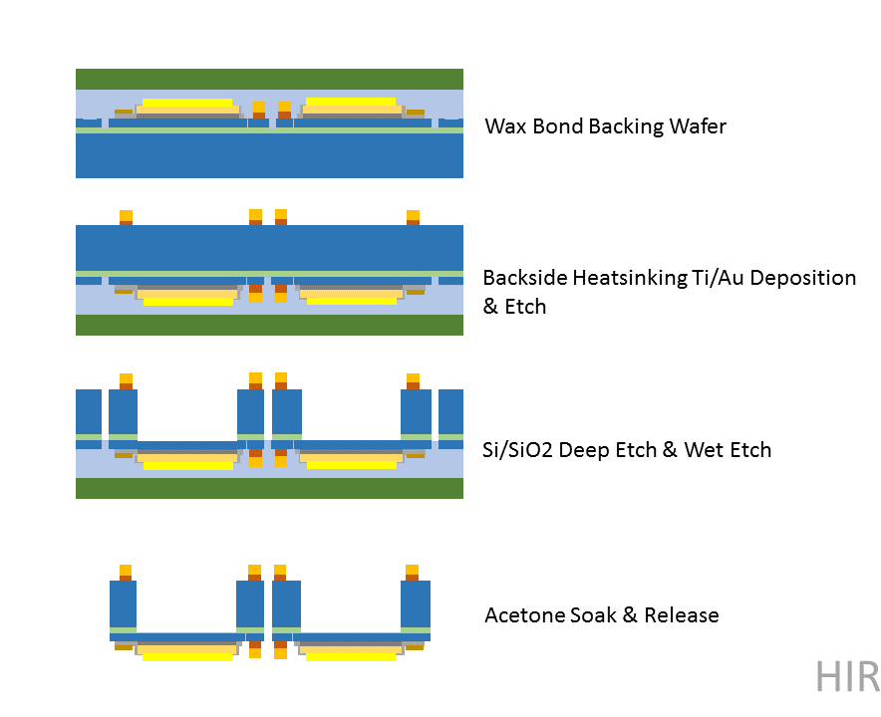
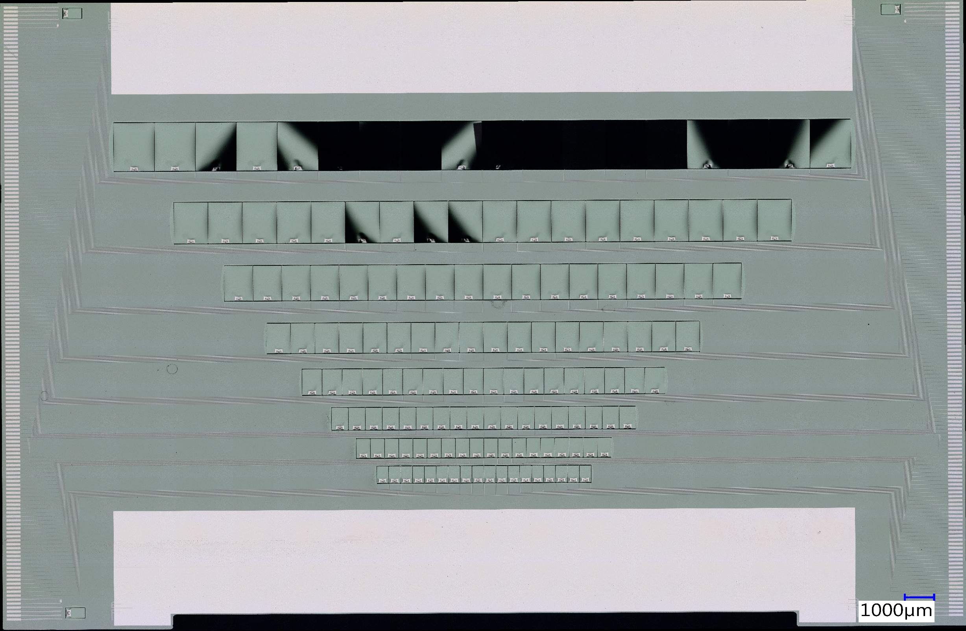
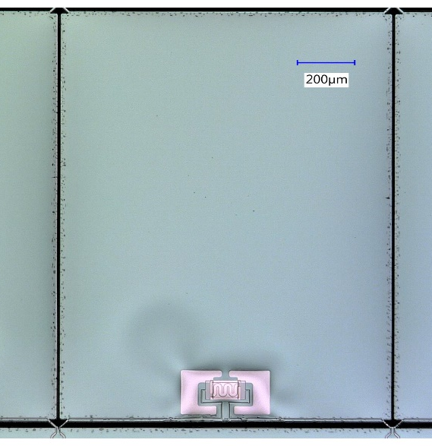
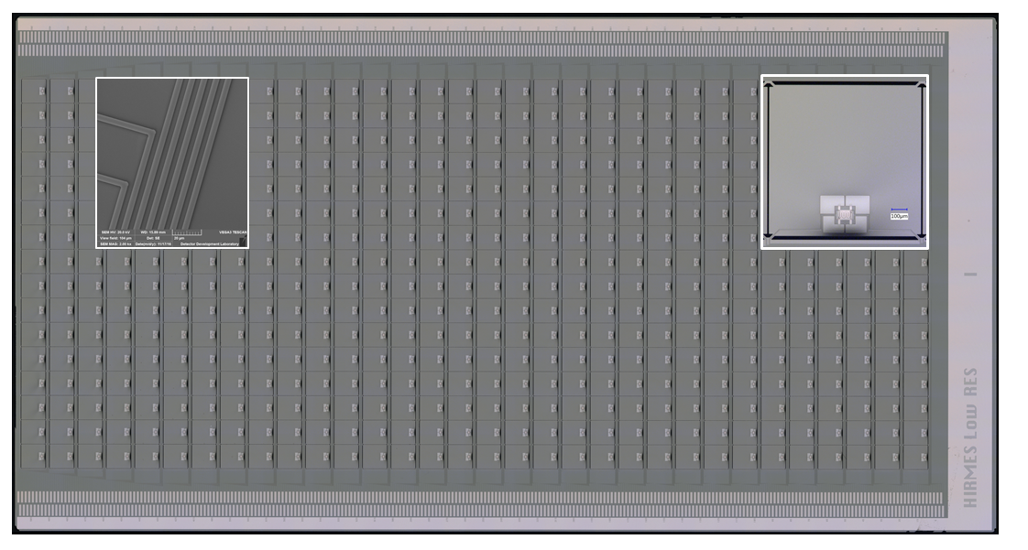
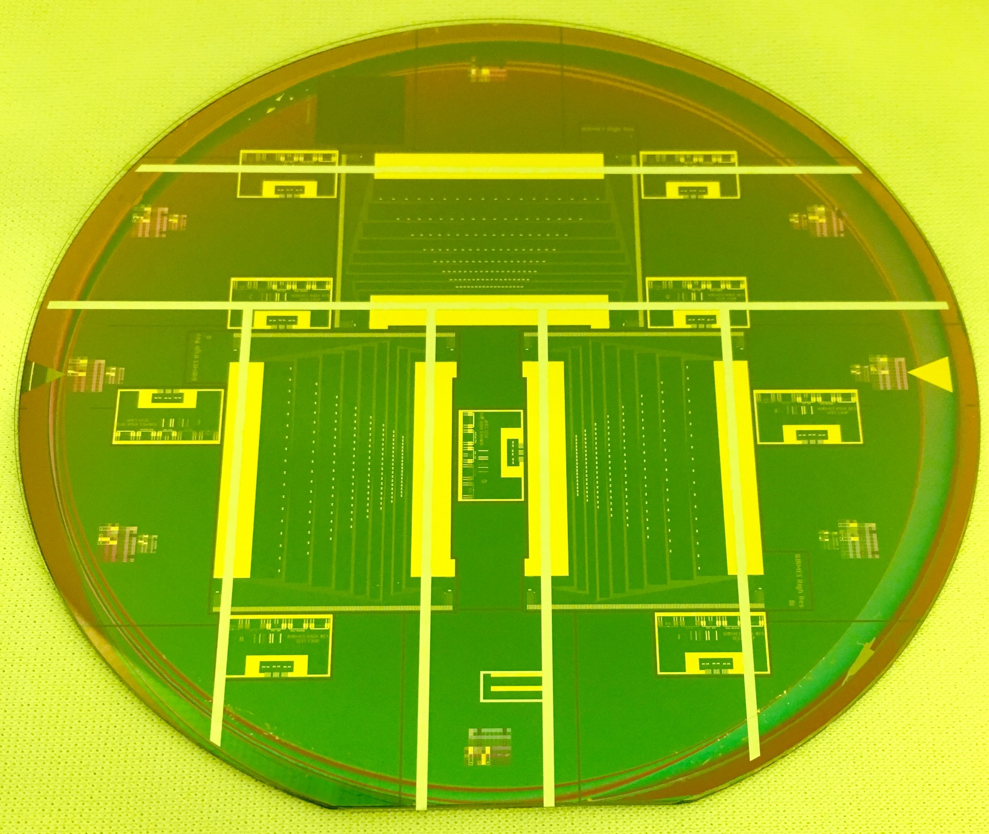
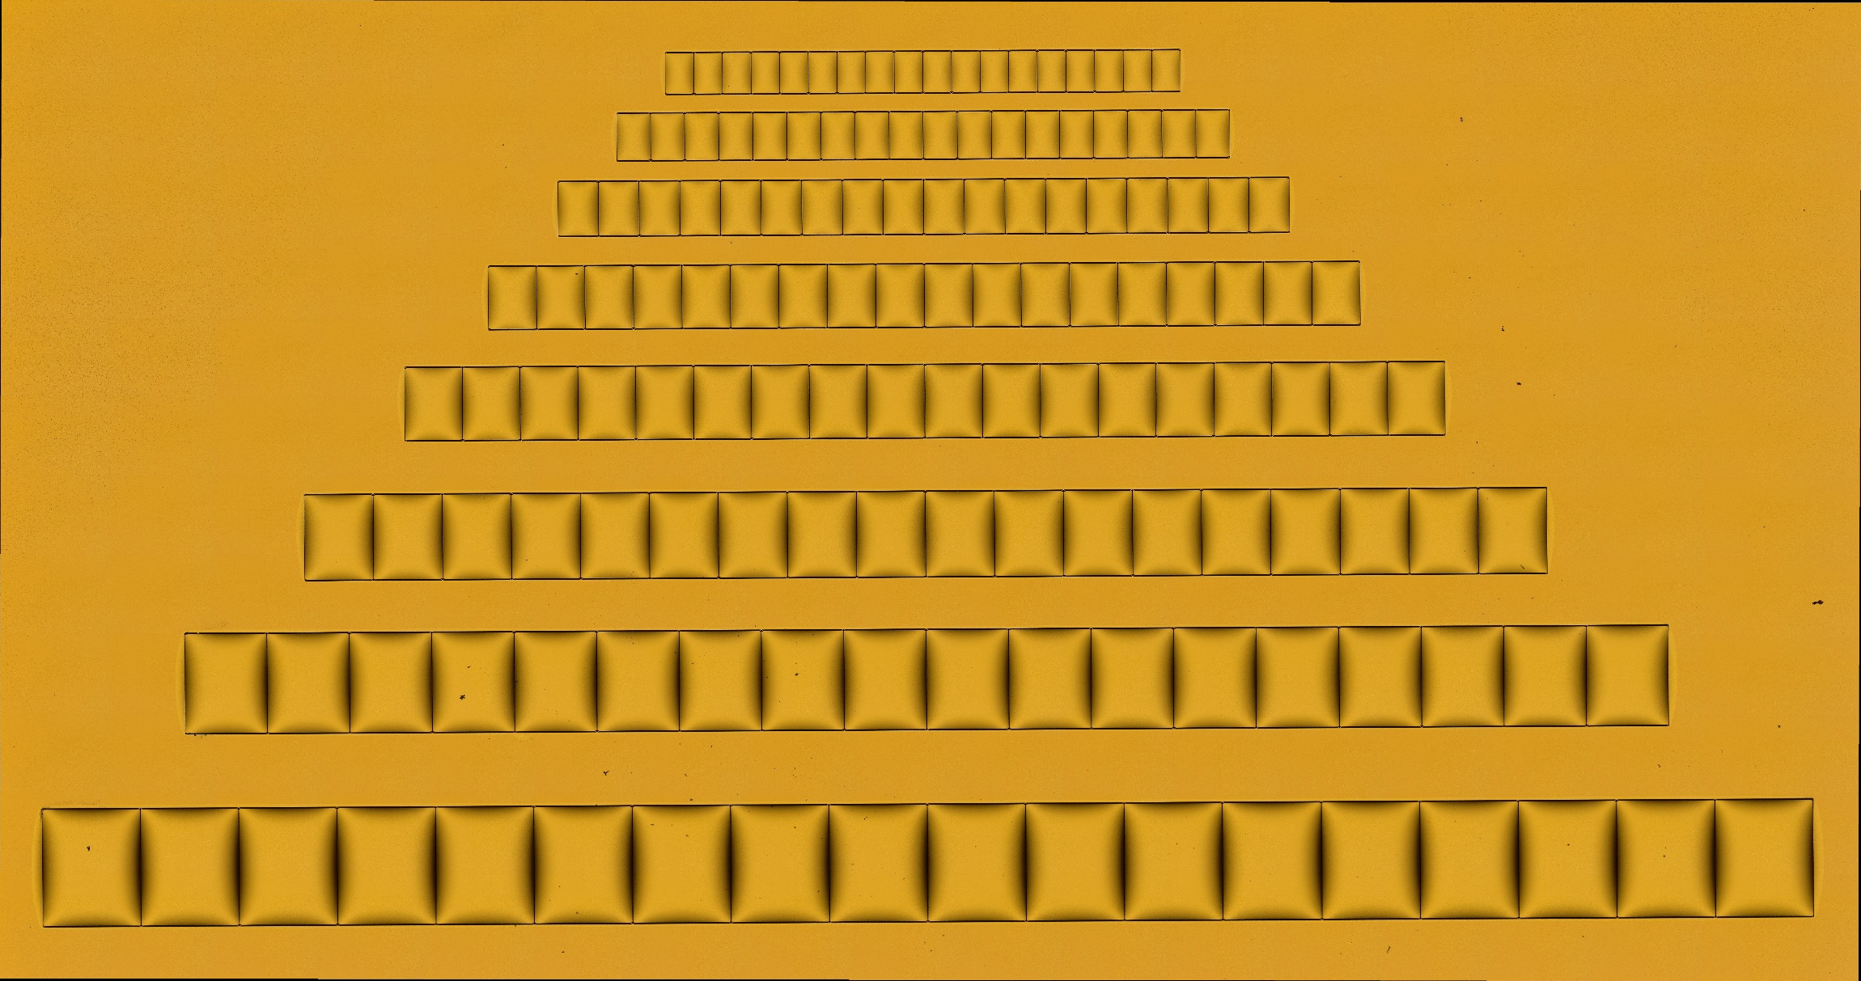
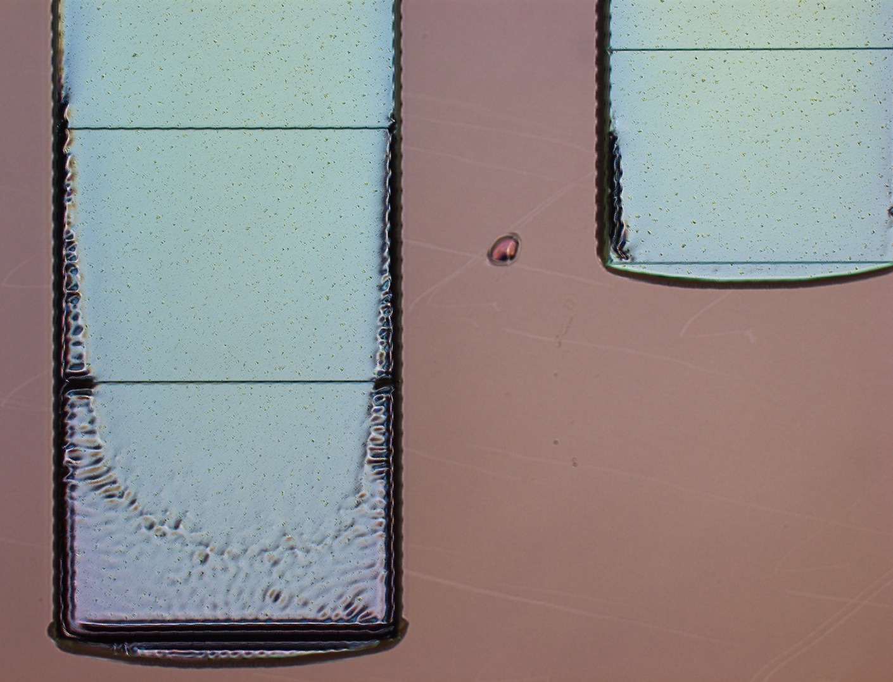
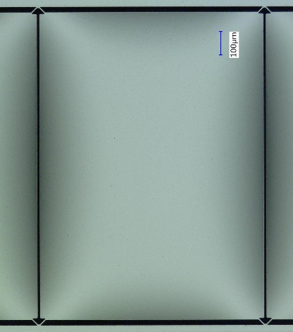
LTD-17 Presentation 1598297
Fabrication of Ultrasensitive Transition Edge Sensor Bolometric Detectors for HIRMES
Ari-David Brown^{1,*}, Regis Brekosky^{1,2}, David Franz¹, Wen-Ting Hsieh¹, Alexander Kutyrev^{1,3}, Vilem Mikula^{1,4}, Timothy Miller¹, S. Harvey Moseley¹, Joseph Oxborrow^{1,5}, Karwan Rostem^{1,6}, Edward Wollack¹
1. NASA Goddard Space Flight Center, Greenbelt, MD 20771 USA; 2. Stinger Ghaffarian Technologies, 7515 Mission Drive, Suite 300, Seabrook, MD 20706 USA; 3. Department of Astronomy, University of Maryland, College Park, MD 20742 USA; 4. Institute for Astrophysics and Computational Science, Catholic University of America, 620 Michigan Ave N.E., Washington, DC 20064 USA; 5. Scientific and Biomedical Microsystems, 806 Cromwell Park Drive Suite R, Glen Burnie, MD 21061 USA; 6. Department of Physics and Astronomy, Johns Hopkins University, 3400 N. Charles St, Baltimore, MD 21218 USA
The high resolution mid-infrared spectrometer (HIRMES) is a high resolving power (R~100,000) instrument operating in the 25-122 μm spectral range and will fly on board the Stratospheric Observatory for Far-Infrared Astronomy (SOFIA) in 2019. Central to HIRMES are its two transition edge sensor (TES) bolometric cameras, an 8x16 detector high resolution array and a 64x16 detector low resolution array. Both types of detectors consist of Mo/Au TES fabricated on leg-isolated Si membranes. Whereas the high resolution detectors, with a noise equivalent power (NEP)~2 $aW/\sqrt{Hz}$, are fabricated on 0.45 μm Si substrates, the low resolution detectors, with NEP~10 $aW/\sqrt{Hz}$, are fabricated on 1.40 μm Si. Here we discuss the similarities and differences in the fabrication methodologies used to realize the two types of detectors.
Generic Fabrication Process for TES Bolometric Detectors: Starting with a Silicon-on-Insulator Wafer
v
High Resolution Detector Array: Si Device Layer = 0.45 μm – Mechanical Yield>70%
Low Resolution Detector Array: Si Device Layer = 1.4 μm – Mechanical Yield>99%
Use of the generic fabrication process results in low pixel yield due to breaking of the silicon thermal isolation legs.
We believe that capillary pressure is partially responsible for leg breakage.
1 mm
1 mm
The capillary pressure is proportional to γ/r, where γ is the surface tension and r is the distance between the (sapphire backing wafer and Si) surfaces was reduced by:
Increasing r by fabricating SU-8 “rails” on the sapphire wafer.
Decreasing γ (to zero) by drying the parts in a critical point dryer once the wax is dissolved.
SU-8 Rails
Micrograph of a 32x16 TES bolometric detector array. Right, the pixel area is 1 mm² and the Si membrane thickness is 1.40 μm. There are four thermal isolation legs which are 15 μm wide and 30 μm long. Left, a scanning electron micrograph of several of the lifted off 4 μm wide Nb leads.
Conclusions & Future Challenges
As membranes get thinner (for low NEP bolometric applications) risk of mechanical failure increases.
A process for achieving high mechanical yield on large filling fraction leg-isolated ultrathin Si membranes was demonstrated.
The SU-8 “rail” process was vetted on a mechanical model. The mechanical yield was 100% in the absence of bubbles in the wax or other defects.
Without rails, the membranes became adhered to the sapphire substrate and broke.
Further developments to increase the yield by adjusting deep reactive etching parameters, in order to prevent wax reflow, are on-going.
Etched with Low Platen Power
2 mm
500 μm
Etched with High Platen Power
This work was supported by a SOFIA Third Generation Instrument Award. The authors gratefully acknowledge suggestions from Kevin Denis, and cryogenic test support from James Chervenak. *ari.d.brown@nasa.gov

