Slide 1




Traveling wave, lumped element kinetic inductance parametric amplifier for detector readout
Saptarshi Chaudhuri, Dale Li, Kent Irwin, Clint Bockstiegel, Johannes Hubmayr, Joel Ullom, Michael Vissers, Jiansong Gao
July 20, 2017

Slide 2
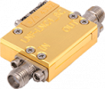
TES, MKID benefit from quantum-limited amplifier
Significant benefits of lower amplifier noise
  MKIDs: improve total noise, esp. dissipation readout
  Microwave SQUIDs: significant noise from HEMT, lower noise floor
State-of-the-art follow-on amplifier: HEMT- T_{N}~2-4 K @ 4-8 GHz
Quantum limit: 48 mK/GHz
  Order of magnitude lower!
Need for broadband, high dynamic range, quantum-limited amplifier
LNF HEMT- T_{N}~2.1 K
Solution: Traveling Wave Kinetic Inductance Parametric Amplifiers

Slide 3
Principles of traveling-wave parametric amplification
Requirements
Traveling-wave structure, i.e. transmission line
Reactive nonlinearity, e.g. current-dependent kinetic inductance L(I)=L₀[1+ (I/I*)²]
Dispersion engineering
  Inhibit pump harmonic growth
  Compensate for nonlinear phase slippage to phase match
Four-wave mixing amplifier
ω_{p}
ω_{s}
Signal
Pump
Idler
ω_{p}
ω_{i}
ω_{s}+ω_{i}=2ω_{p}
Phase match for max gain: k_{s}+k_{i}=2k_{p}

Slide 4
Background: Dispersion-engineered amplifier with periodically loaded CPW
λ_{per}/2
Z₀=200 Ω
X 10⁻³
0
-100
-200
-300
-400
-500
-600
-700
-800
5
4
3
2
1
0
-1
-2
-3
-4
-5
f_{per} /3
Normalized Power Transmission (dB)
2f_{per} /3
Dispersion k_{eff}-k₀ (m⁻¹)
Pump
f_{per}
0 5 10 15 20 25 30 35 40
Frequency (GHz)
10.5 11 11.5 12 12.5 13
Frequency (GHz)
NbTiN (Ic~mA) used for high dynamic range amplification
Stopbands inhibit harmonics, achieves phase match for max gain
Initial demo in Eom et al., Nature Physics 8, pp. 623-627 (2012)

Slide 5
Successful amplifier, but problems with yield, gain ripple, and noise
~10 MHz ripple period
CPW spiral 2m length- most chips failed due to opens/ shorts
Large, dense gain ripple- mismatch with external circuit
Pump power of ~200 μW- on-chip heating, thermal noise
  Noise temperature as low as 1 K- 2x better than any HEMT!

Slide 6
Towards a more practical amplifier: Lumped-element transmission line
L
L
L
L
L
L
L
Port 1
C/2
C
C
C
C
C
C
C/2
Port 2
Inductor strip/ IDC architecture more compact, robust than CPW
  Better yield expected!
Harmonics naturally inhibited by low-pass cutoff
Easy to get 50 Ω impedance, no tapers needed
  Simpler matching, lower power

Slide 7
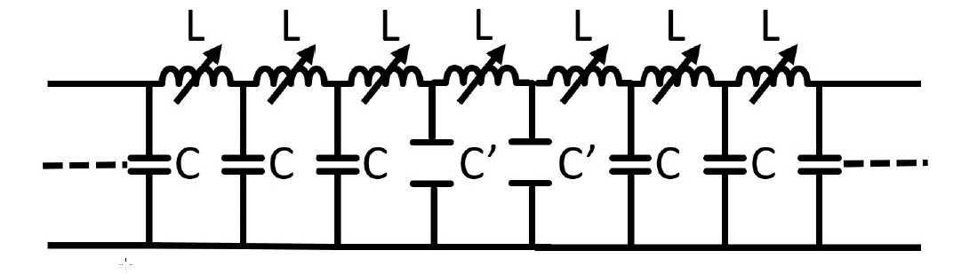
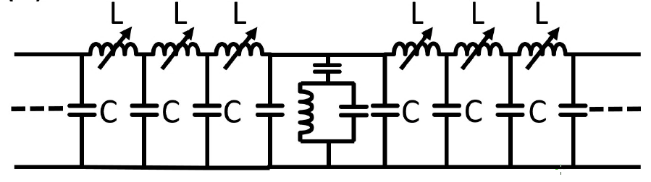
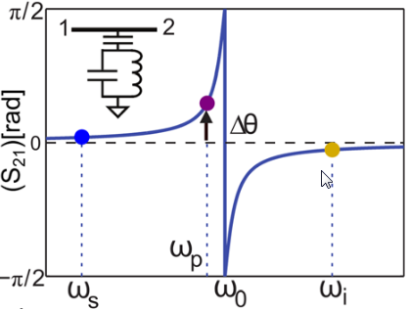


Phase matching with lumped- element paramps
Periodic Loading
NEW!: Resonator Phase Shifter
$$\frac{π}{2}$$
Lumped element analog of CPW loading
Operate far below cutoff- LC looks distributed
Change capacitance to introduce stopbands, dispersion
(S₂₁)[rad]
∆θ
0
ω_{p}
$$−\frac{π}{2}$$
ω_{s}
ω_{r}
ω_{i}
Periodic resonators act as ideal phase shifters to correct mismatch
Enables phase matching at higher nonlinearities now observed in NbTiN

Slide 8
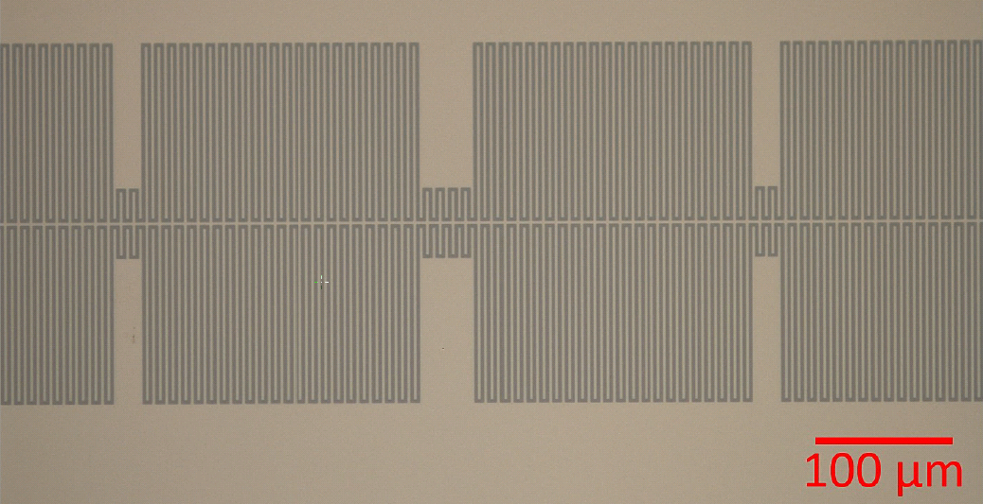
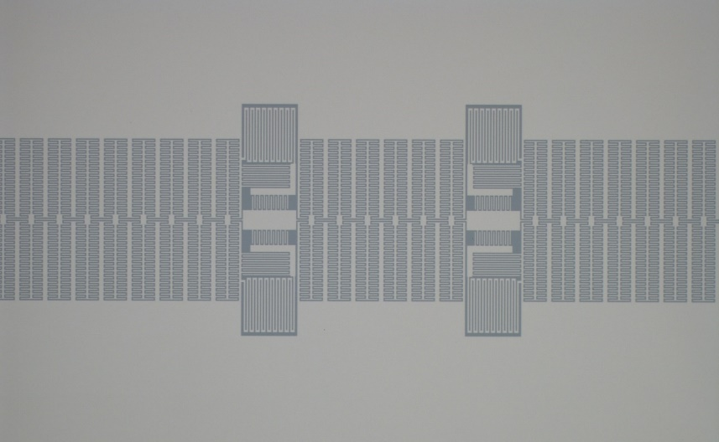
Amplifier design
Periodic Loading
Resonator Phase Shifter
Resonator Block
Loadings
100 μm
Design Parameters | Periodic Loading | Resonator Phase Shifter
Pump Frequency | 6 GHz | 6 GHz
Impedance | 50 Ω | 50 Ω
Cutoff Frequency | 318 GHz | 55 GHz
Length | 10 cm (70 wavelengths) | 10 cm (70 wavelengths)
Phase Matching | C reduced 5x: 50 Ω → 111 Ω | 6 resonator blocks

Slide 9
Amplifier design
Periodic Loading
Resonator Phase Shifter
Resonator Block
Loadings
100 μm
Design Parameters | Periodic Loading | Resonator Phase Shifter
Pump Frequency | 6 GHz | 6 GHz
Impedance | 50 Ω | 50 Ω
Cutoff Frequency | 318 GHz | 55 GHz
Length | 10 cm (70 wavelengths) | 10 cm (70 wavelengths)
Phase Matching | C reduced 5x: 50 Ω → 111 Ω | 6 resonator blocks
Much smaller! Exploit higher nonlinearities for more efficient gain.

Slide 10
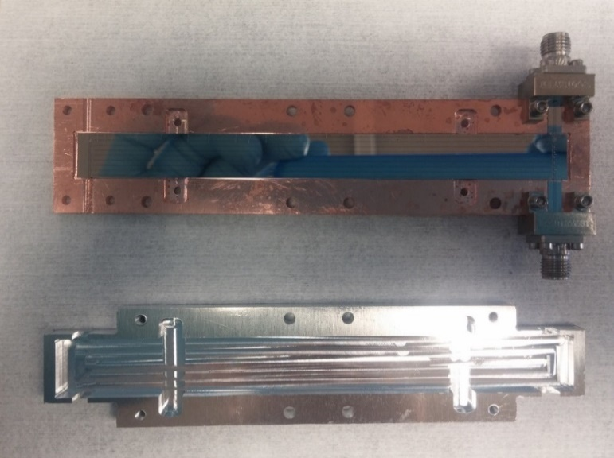
Amplifier fabrication and packaging
1 cm
10 cm
9 amplifier lines per chip, 8 chips on 6” wafer
2/3 of all lines show good Ic, RF transmission
Much improved device fabrication yield

Slide 11
Initial results: 15 dB gain, 10x less length, 3x less power!
≥1 GHz of bandwidth on each side of pump sufficient for many applications
Future resonator versions will have higher Qc phase shifters to match periodic loading bandwidth
Periodic Loading
Resonator Phase Shifter
Pump
Pump

Slide 12
Close to 50 Ω, but excess mismatch still there
Periodic Loading
Resonator Phase Shifter
Measured 47 Ω device impedance
Mismatch at ports still present- wirebonds to blame?

Slide 13
Parasitic features now clearly observed
Periodic Loading
Resonator Phase Shifter
No discernable correspondence to length scales
Likely due to environmental coupling, i.e. to box

Slide 14
Next steps
Noise measurements
  Does 3x lower power help by reducing thermal noise?
Heat-sinking and thermal noise mitigation
  Lower trace width, different materials for lower power?
Improve RF ground + connectorization to reduce ripple/parasitics
  Increase groundplane wirebond density
  Continuous connections to ground possible with new architecture
  Mitigate impedance mismatch from ports
Careful analysis of TES/MKID readout applications

Slide 15
Important application for parametric amplifiers: Light-field dark matter searches
Trio of posters this week:
  A. Phipps- the DM Radio “grand vision” (PE-15)
  S. Kuenstner- the DM Radio Pathfinder (PA-73)
  S. Chaudhuri- fundamental limits on detection (PE-24)

Slide 16
Summary
Lumped-element traveling-wave parametric amplifier demonstrated with much smaller length, lower power, and higher fabrication yield
Much more practical amplifier
For details: S. Chaudhuri, D. Li, K.D. Irwin, C. Bockstiegel, J. Hubmayr, J.N. Ullom, M.R. Vissers, and J. Gao, Appl. Phys. Lett. 110, 152601 (2017).

