Slide 1
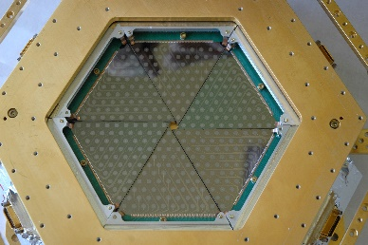
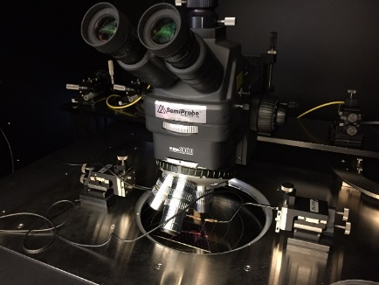
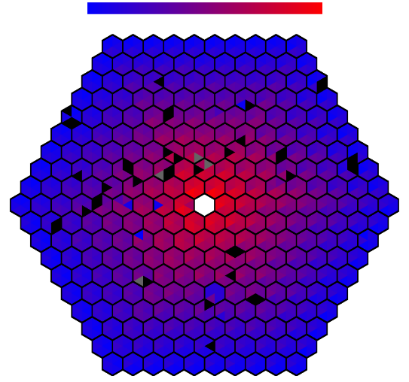
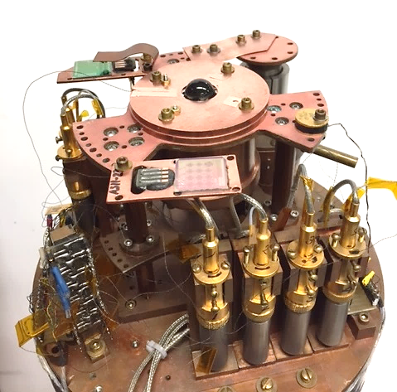
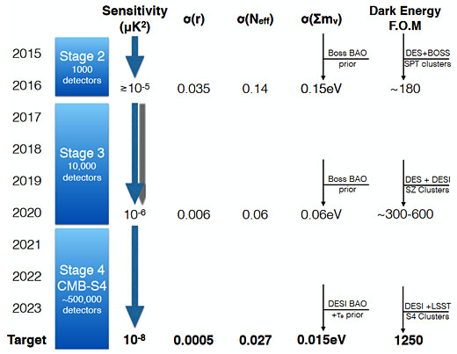
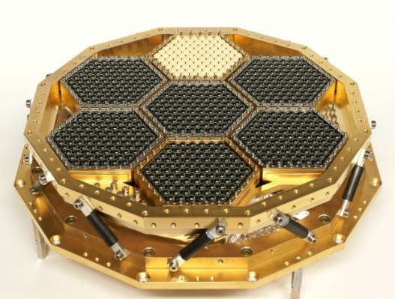
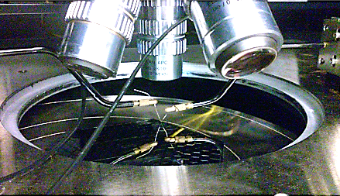
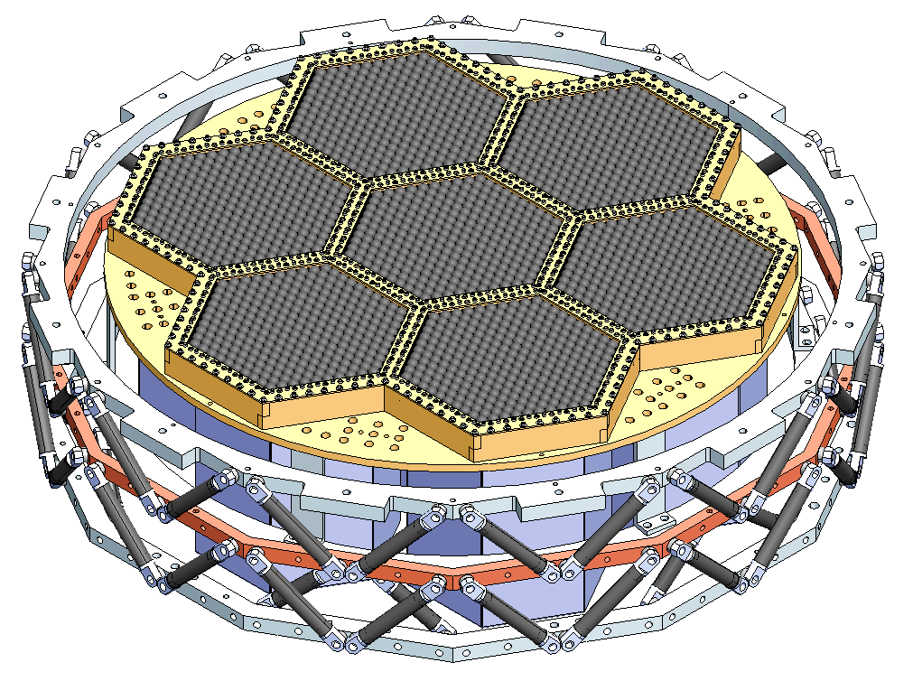
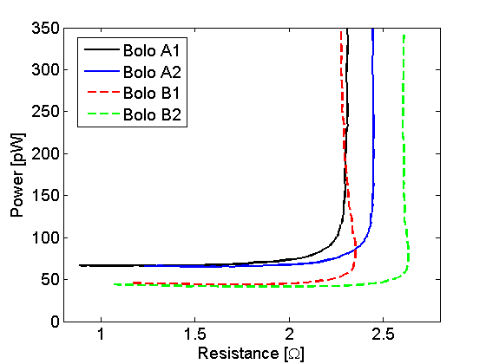
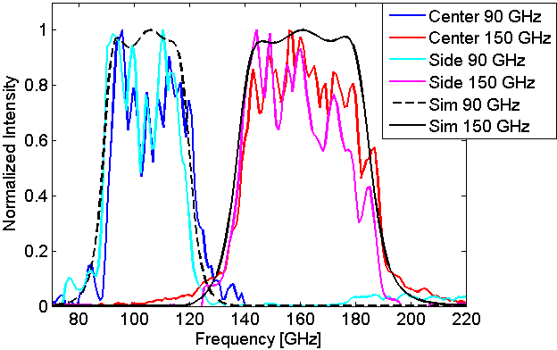
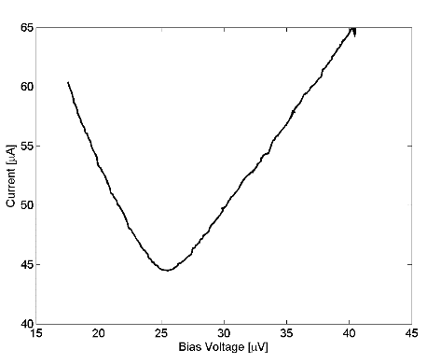
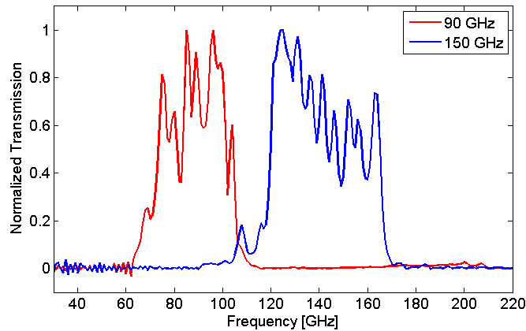
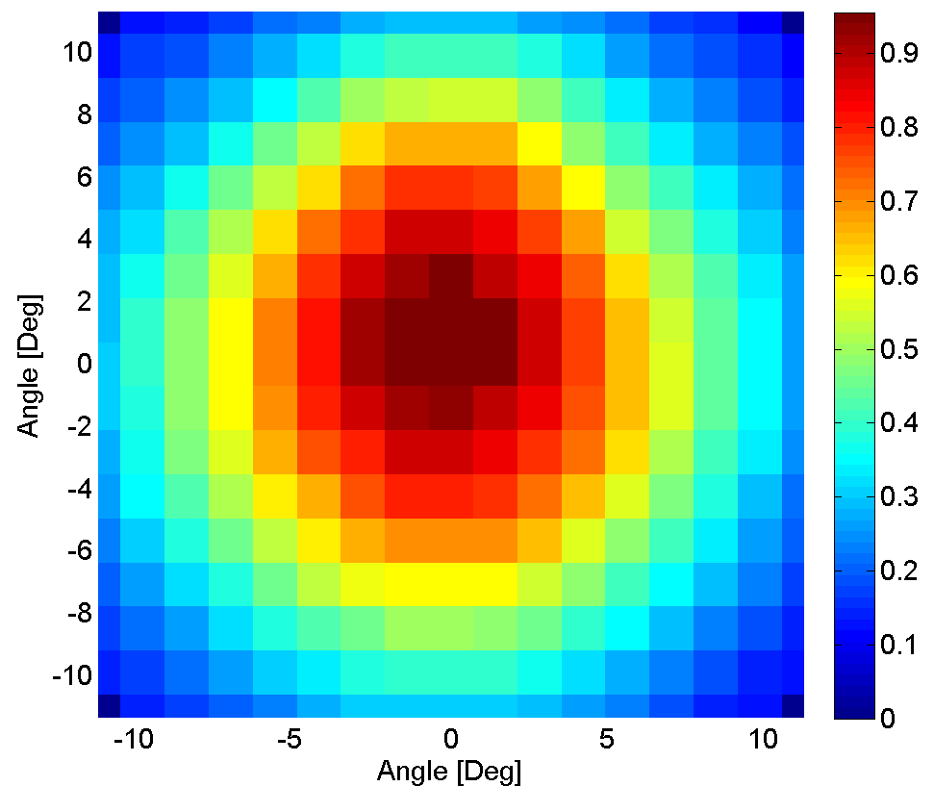
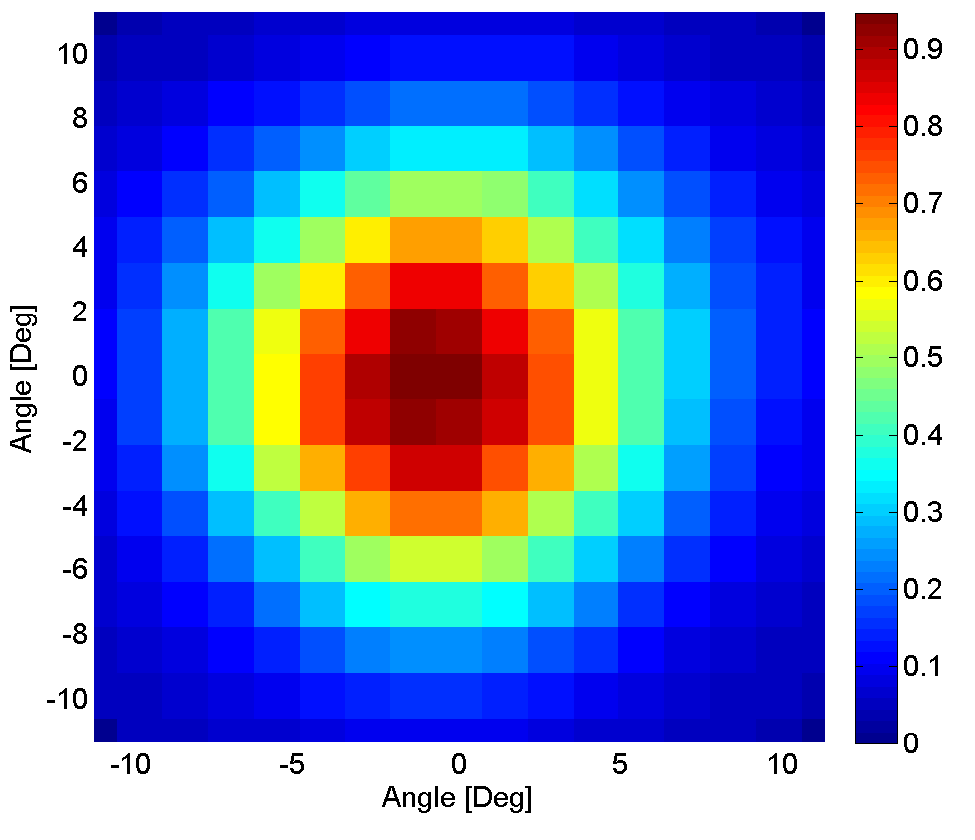
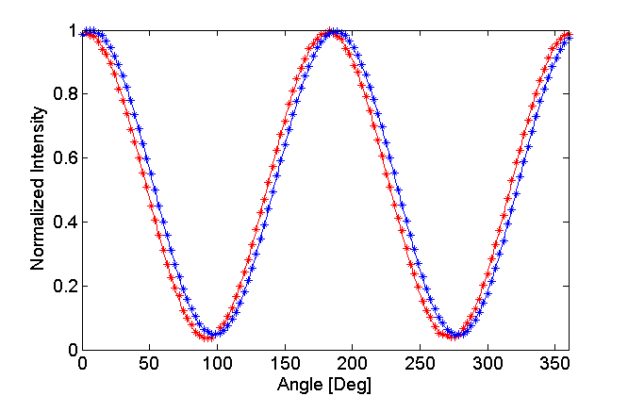
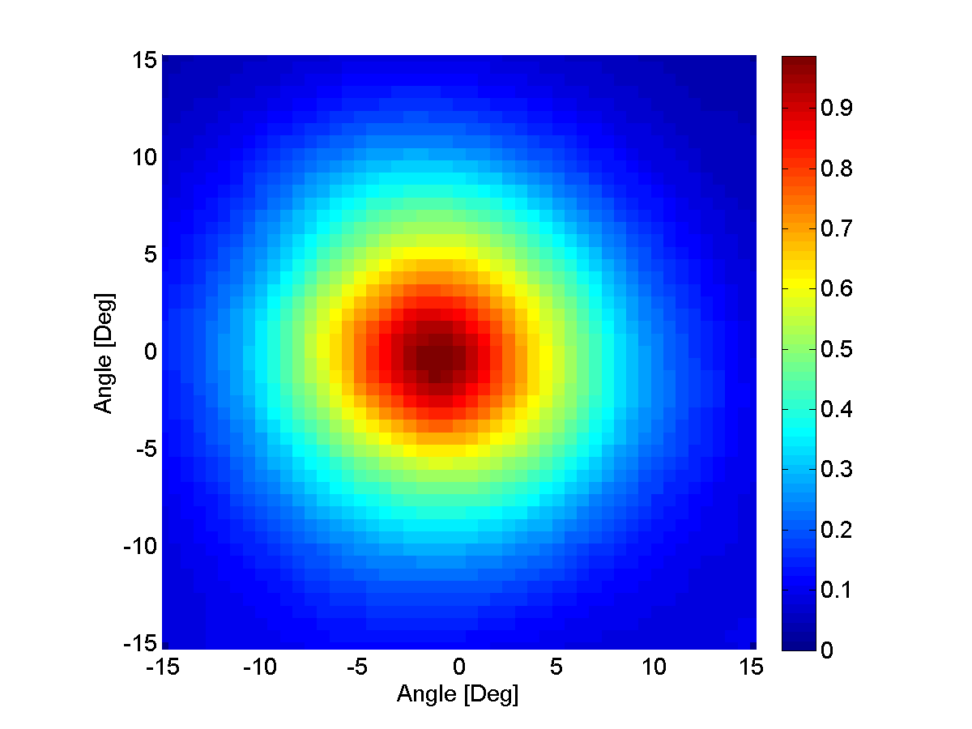
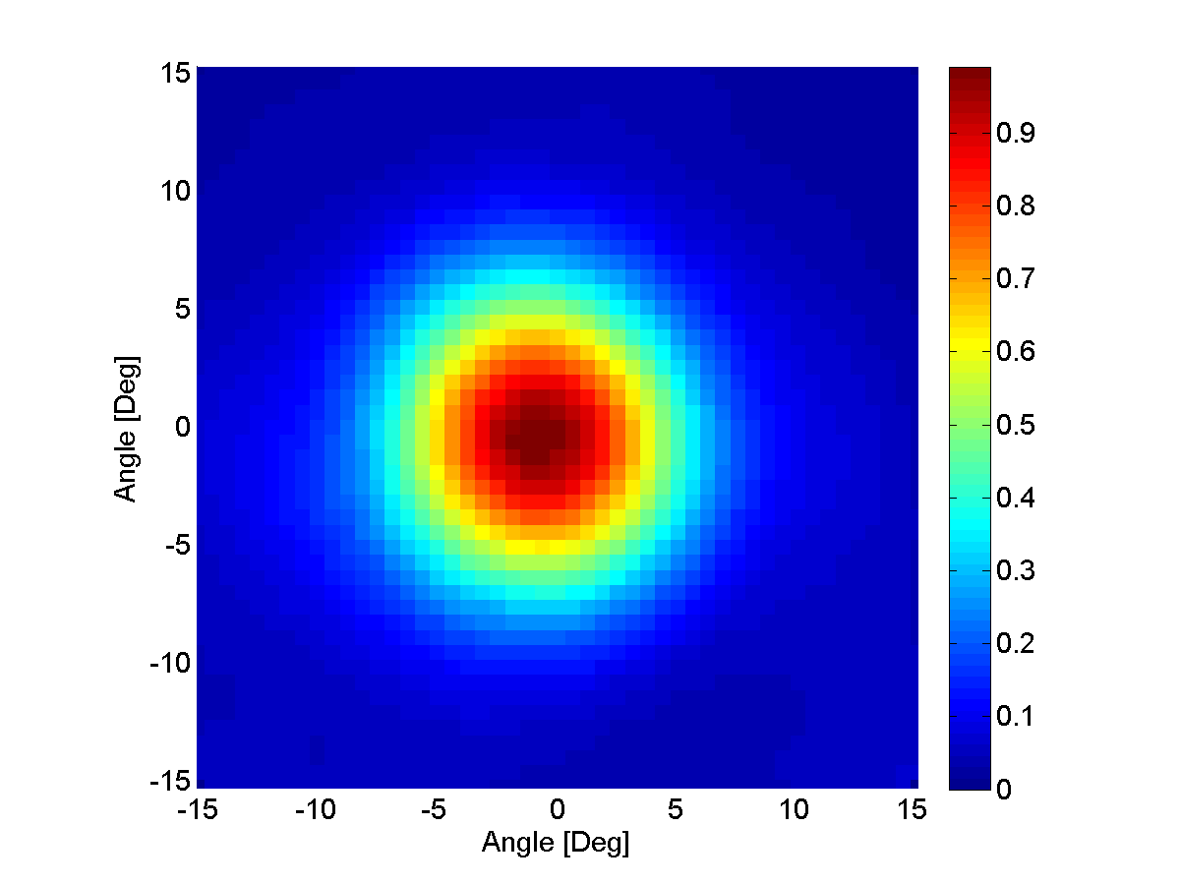
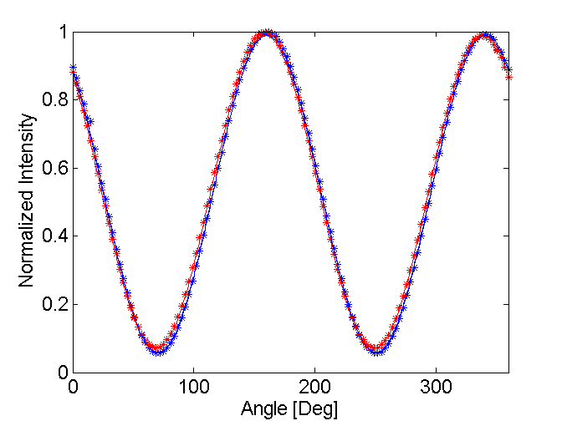
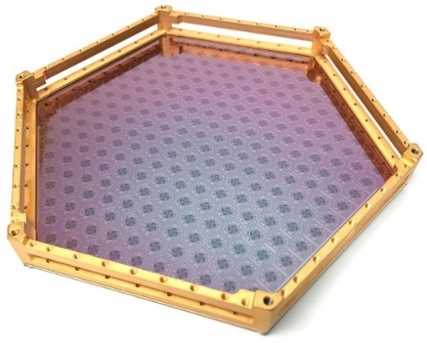
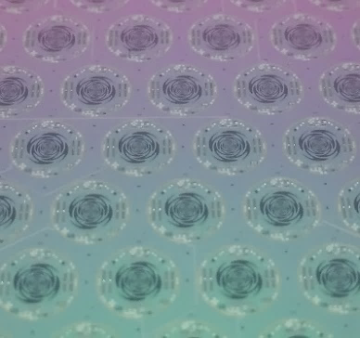
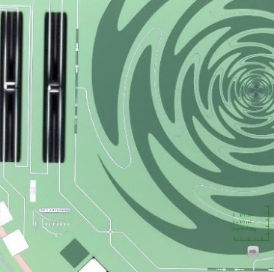
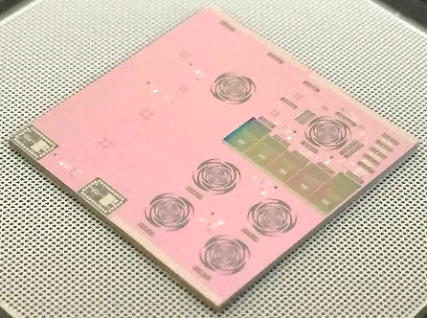
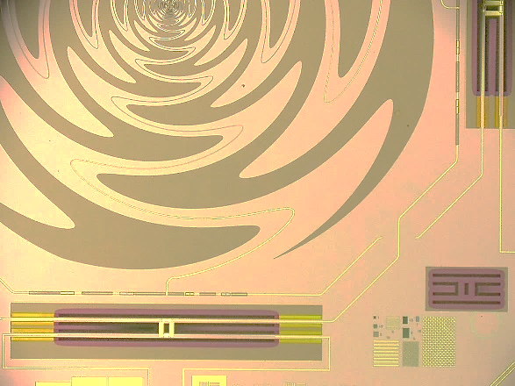
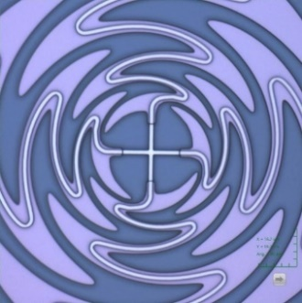
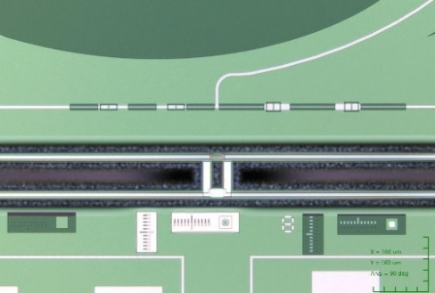
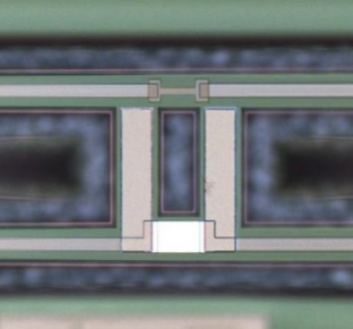
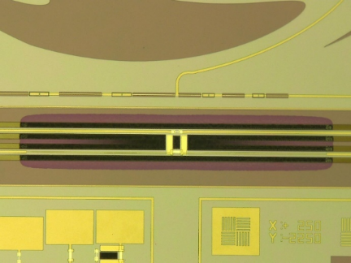
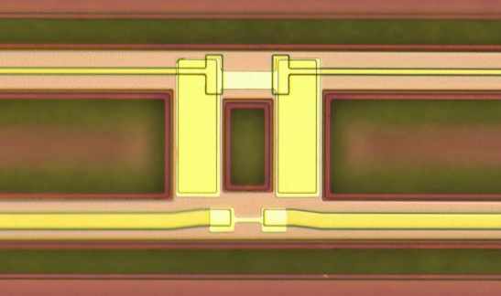
Commercialization of micro-fabrication of
antenna-coupled Transition Edge Sensor bolometer detectors
for studies of the Cosmic Microwave Background
PC-6
Aritoki Suzuki*^{1,2}, Chris Bebek¹, Maurice Garcia-Sciveres¹, Stephen Holland¹,
Akito Kusaka^{1,4}, Adrian T. Lee², Nicholas Palaio¹, Natalie Roe¹, Leo Steinmetz²
1) Physics Division, Lawrence Berkeley National Laboratory, Berkeley, CA 94720, USA
2) Physics Department, University of California, Berkeley, CA 94720, USA
3) Engineering Division, Lawrence Berkeley National Laboratory, Berkeley, CA 94720, USA
4) Department of Physics, University of Tokyo, Tokyo 113-0033, Japan
* E-mail: asuzuki@lbl.gov
Introduction
Test Results
16 cm
0 ꭥ
20K ꭥ
Test pixel
He-3 fridge
APEX-SZ
330 detectors
20 cm
Stage-II
~1,000 detectors
Dual-Polarization
1 Color/pixel
36 cm
Stage-III
~10,000 detectors
Dual-Polarization
2-3 Color/pixel
Automatic probe station
Resistance map of detector array fabricated at HYPRES
Stage-IV
~500,000 detectors
Dual-Polarization
Material | Thickness [Å]
Niobium | 5300 ± 100
Silicon Oxide | 5100 ± 100
Expected sensitivity increase for CMB-S4 [1]
Adrian T. Lee CMB-S4 Workshop at LBNL (March 2016)
DC SQUIDs
Automatic probe station
8-inch IR-labs wet dewar
Motivation:
A concept for a Stage-IV experiment, CMB-S4, is emerging to make a definitive measurement of CMB polarization from the ground with O(500,000) detectors [1]
Stage-IV experiment will require O(500) detector wafers
The orders of magnitude increase in detector count for Stage-IV experiment requires a new approach in detector fabrication to increase fabrication throughput
Approach
We worked collaboratively with two commercial micro-fabrication foundries to fabricate antenna coupled TES bolometer detectors
Benefits
Industrial-scale fabrication to increase throughput and reduce cost per wafer
Commercial techniques for stringent quality assurance could improve uniformity, repeatability, and yield
Eliminate the need to invest in large fabrication facilities and expensive equipment
Room temperature wafer characterization
Developed automatic probe station to check DC connectivity at room temperature
Achieved electrical yields as high as 97%
Film thicknesses were measured with ellipsometer and profilometer
Film thicknesses were within specification ( < 2% non-unifmormty)
PR curve
Spectra
90 GHz
150 GHz
IV curve
Spectra
90 GHz
150 GHz
90 GHz beam
150 GHz beam
Polarization measurement with a rotating wire grid
90 GHz beam
150 GHz beam
Polarization measurement with a rotating wire grid
Design and Fabrication
Test results from devices from HYPRES
Test results from devices from STAR Cryoelectronics
130 mm
Cryogenic temperature detector characterization
Characterized in 8-inch IR labs wet dewar with Helium-3 fridge and DC SQUID readout
Devices from both foundries worked well
TES bolometers showed the expected I-V responses
RF performance:
Polarization sensitive detector
Dual color spectra that agrees with simulation
Round beams from two frequency bands
Uniform performance across detector array
20 mm
20 mm
Sinuous Antenna
Diplexer Filter
Detector Array
Array of Pixels (6mm)
Pixel Overview
Test chip
90 GHz
150 GHz
TES Bolometer
Antena, Bolometer & RF Filter
Sig from antenna
Termination resistor
Conclusion and Future Developments
1 mm
90μm
Center of Sinuous (2um line)
RF Filter and TES Bolometer
TES Bolometer
bias leads
TES
We took a staged approach to develop CMB detector fabrication with commercial foundries with the following steps:
Make a bolometer
Make an antenna-coupled bolometer
Make an antenna-coupled bolometer detector array
Make an antenna-coupled bolometer detector array with optimized characteristics
Demonstrate mass production of detector arrays with optimized characteristics
We have completed stages 1,2, and 3 with promising results; step 4 is in progress
This R&D could open a new approach to fabricate CMB detectors for future experiments
Detector Array Co-Fabricated with HYPRES
Bolometer & RF Filter
Bolometer Island
Prototype Chip Fabricated at StarCRYO
Foundries:
We collaborated with two commercial foundries that specialize in
micro-fabricated Niobium devices:
HYPRES Inc. http://www.hypres.com/
STAR Cryoelectronics https://starcryo.com/
Design:
The detector design was based on the sinuous antenna coupled dichroic detector from the POLARBEAR-2 experiment (poster PC-7)
Designed prototype test chip with various detector designs
Designed 271 pixel detector array to verify detector array fabrication capability
Fabrication
Detectors were fabricated on 150 mm diameter silicon wafers
Fabrication steps were based on the POLARBEAR-2 detector design (poster PC-7)
STAR Cryoelectronics fabricated a prototype chip with aluminum TES
All fabrication steps were done at STAR Cryoelectronics
HYPRES fabricated a prototype chip and a detector array
Aluminum-Manganese deposition and XeF2 bolometer release steps were done at the UC Berkeley Nanofabrication Laboratory
Acknowledgement
This work was supported by Laboratory Directed Research and Development (LDRD) funding from Berkeley Lab, provided by the Director, Office of Science, of the U.S. Department of Energy under Contract No. DE-AC02-05CH11231
We thank Dr. Daniel Yohannes, Dr. Oleg Mukhanov, and Dr. Alex Kirichenko from HYPRES Inc. for valuable suggestions and feedback that led to successful fabrication
We thank Dr. Robin Cantor from STAR Cryoelectronics for valuable suggestions and feedback that led to successful fabrication
References
[1] CMB-S4, Science Book, First Edition , arXiv:1610.02743 [astro-ph.CO] (2016)

